Slide 1
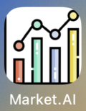
COM4101 Senior Project
Intelligent Mobile app for daily use
Market.AI
Group 11
Lau Ka Pui s226064
Mak Wai Hang s207900
Shum Wing Lam s207902
Tong Yuen Yu s207905

Slide 2

Market.ai
Download and install our app!

Slide 3
Table of contents
01
02
03
04
05
06
Market analysis
Our app
main Features
The market gap
Objectives
Comparison
Common & Novel Features
Development details
Analysis and test cases
Demo
Architecture/flow charts
Trend finding analysis

Slide 4
Market analysis
01

Slide 5



Market size of stock trading and investing applications : USD 24.1 billion
Futubull-Easy Investment
Release in 2013
Investing.com: Stock Market
Release in 2013
Yahoo Finance – Stock Market
Release in 2015

Slide 6
Our app
02

Slide 7
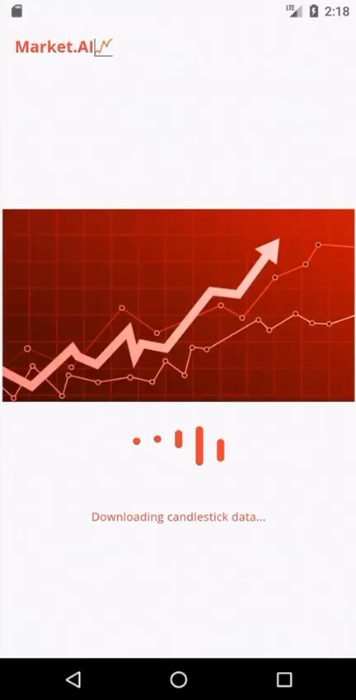
The Market.AI app
Development idea
GOALS
License/regulations
Insert iPhone screen recording here
Demands of free chart pattern tools increased base on Global Market needs
Providing a clearer information via Customizable financial tool that assess data of historical trends & stock prices
Provide users more information to study the stock historical trends
Assist users to analyze the stock market
The following activities are exempted according to The Regulations of Hong Kong & SFC :
Providing generic factual market information
Providing analytical tools
DO NOT need a HKMA/SFC license
NO investment opinions & predictions

Slide 8
Comparison
 | AI Analysis | Prediction | Trend Matching + Subsequent trends Analysis | Financial News
 | yes | yes | no | yes
 | no | no | no | yes
 | no | no | no | yes
 | yes | no | yes | yes

Slide 9
features
03

Slide 10
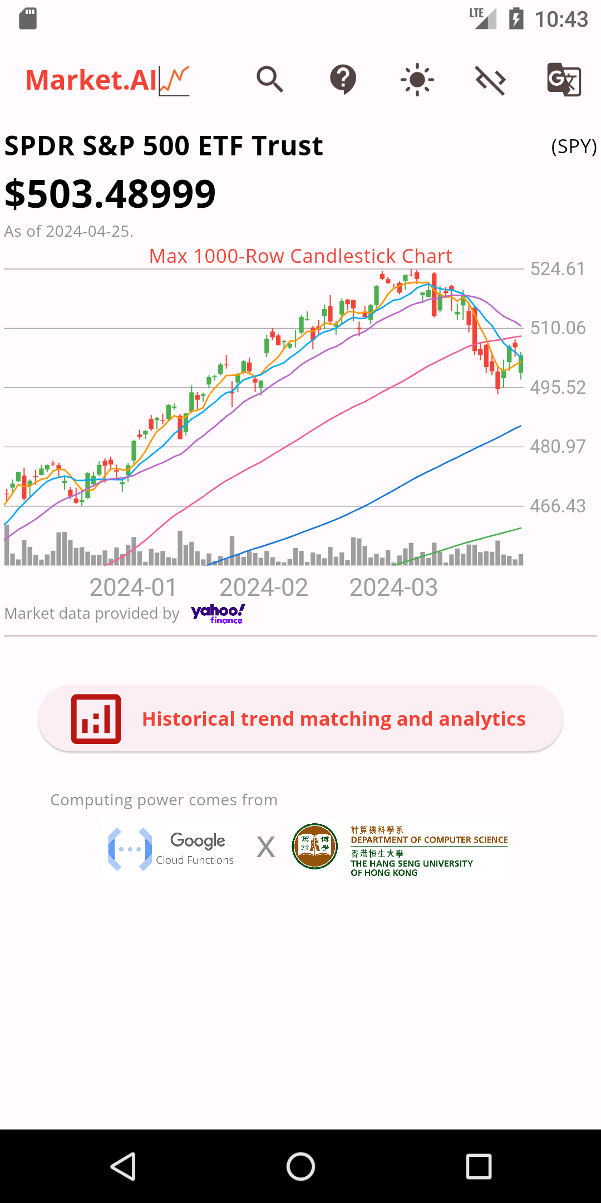
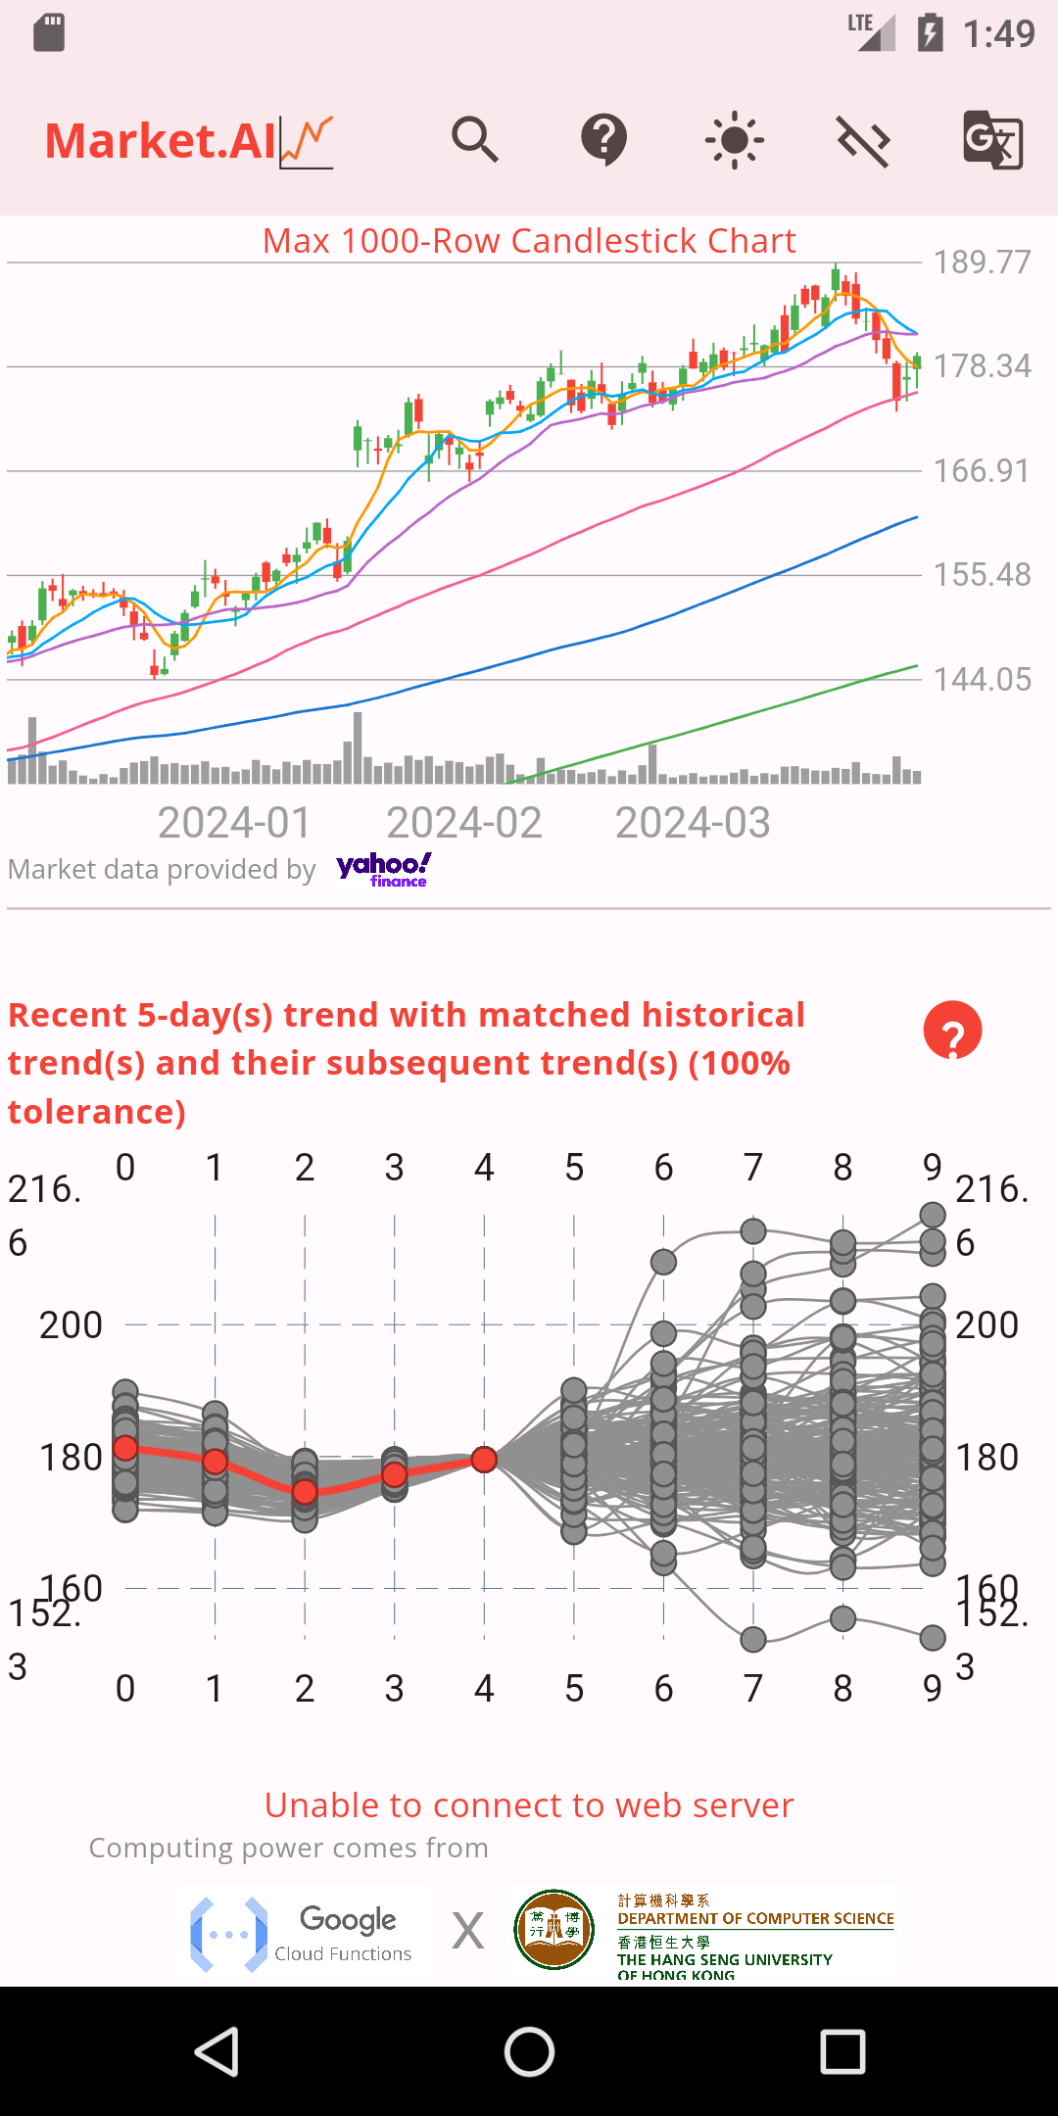
Main features
01
Candlestick charts
02
Historical trend matching
03
Subsequent trend analysis

Slide 11
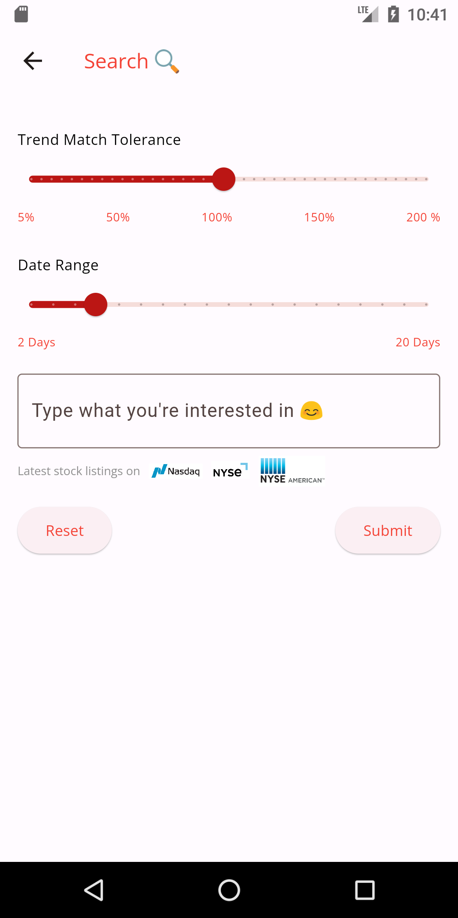
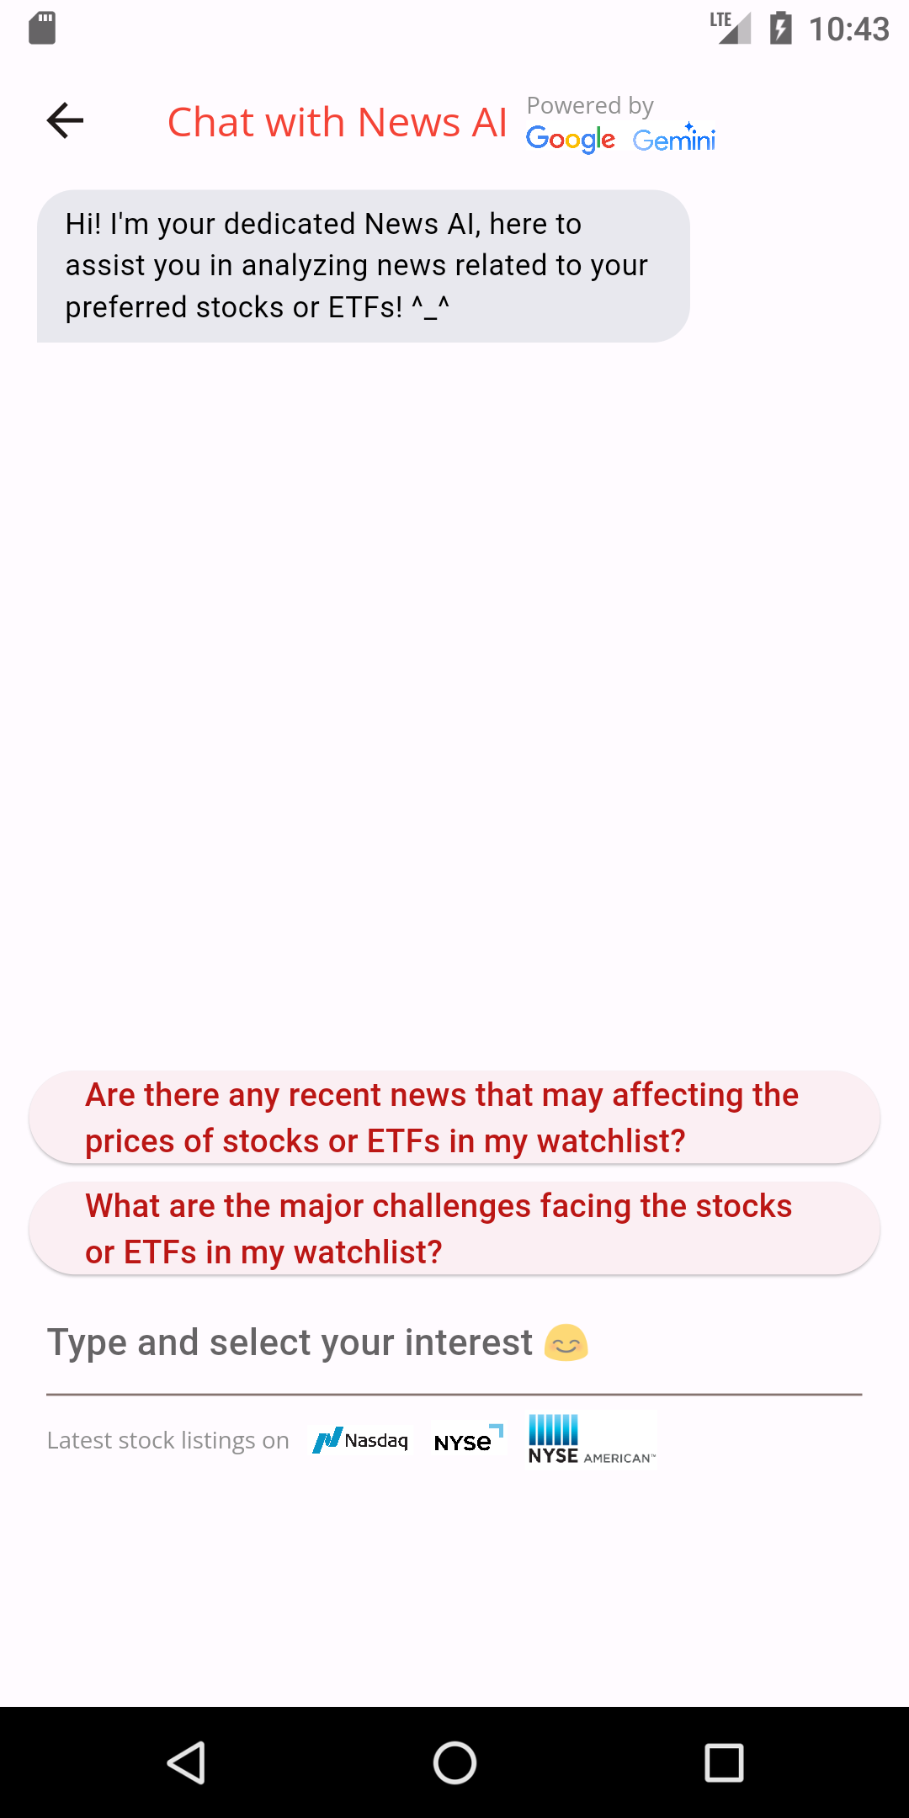
Main Features
04
Customized search
05
Generative AI aided news provider

Slide 12
04
Development details
Architecture & concpets

Slide 13












Activity diagram
The app started and displayed a splash screen
Fetch stock data 'text/csv' from Yahoo finance
GET request stock listings from Nasdaq, NYSE, and NYSE Amex
URLs. Except the NYSE ETF listing going from Compute Engine to a specific Cloud Function and back from Cloud Storage. (application/json)
Save new change(s) in ROM via shared prefs
Convert CSV to List<CandleData>
Start searching on the search page
Show candlestick chart and 'Start trend matching and analytics' btn
Save new change(s) in ROM via shared prefs
Click/ Always show
No
Go to
Add to/ remove from watchlist
Yes
Save new change(s) in ROM via shared prefs
Trend matching and analytics begins
Show/hide extra charts, tables, MA appbar btn, and toggle btn(s)
Return row numbers of matched trends
Enable/disable dev mode
Show trend matching results on chart and tables
Receive 'text/plain' response, then temporarily store it in RAM, save it in ROM via shared prefs, and show the msg
Return list of current last close prices with adjusted matched trend subsequent trends
Get news via GNews and analyze via Gemini Pro 1.5 and return 'text/plain text' results
POST them to Compute Engine to specific Cloud Function for analytics
Receive 'application/json' response, then temporarily store it in RAM, save it in ROM via shared prefs, parse it, convert the base64 binary to PNG, plot them
GET request with parameter 'msg' to Cloud Compute to Cloud Function
Start chatting on the News AI page

Slide 14
Activity diagram
Python Subsequent trend analysis functions (Taiwan)
APP client
Gnews
Trend matching function
GCP xxx engine (Taiwan)
Gemini
GCP server
Yahoo finance

Slide 15
Class diagram

Slide 16
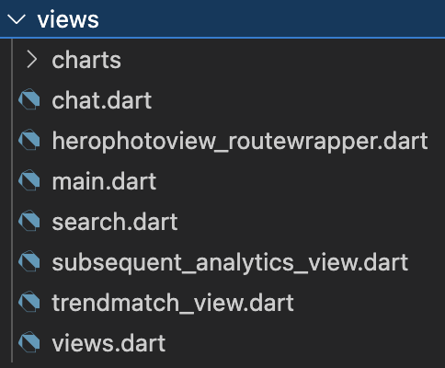
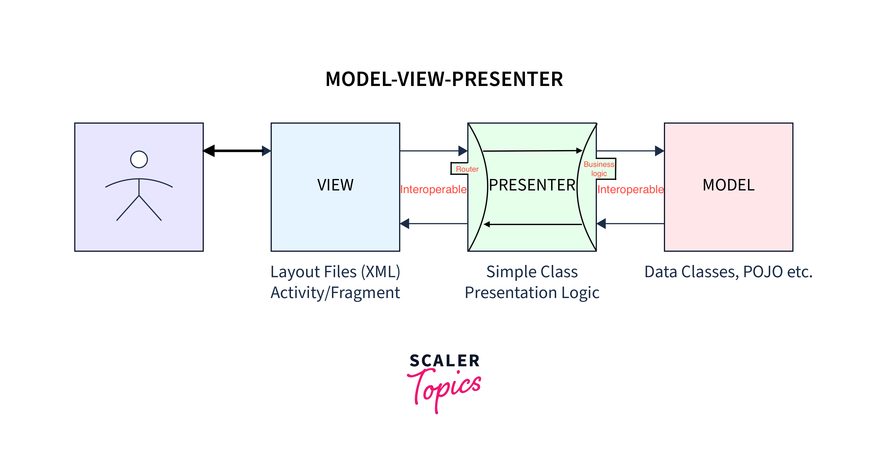
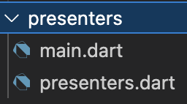
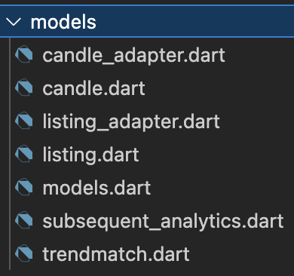
Software design patterns Used
MVP Architecture

Slide 17
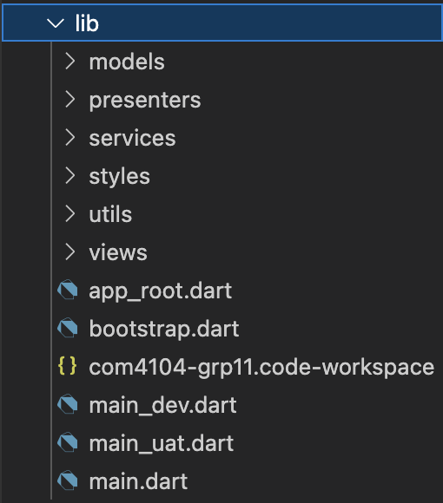
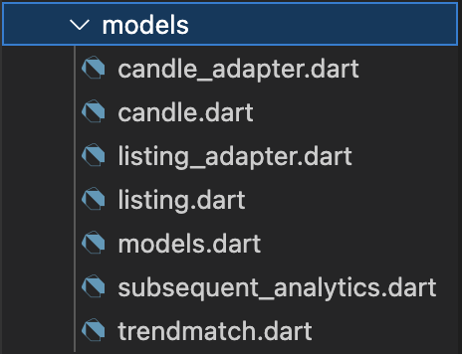
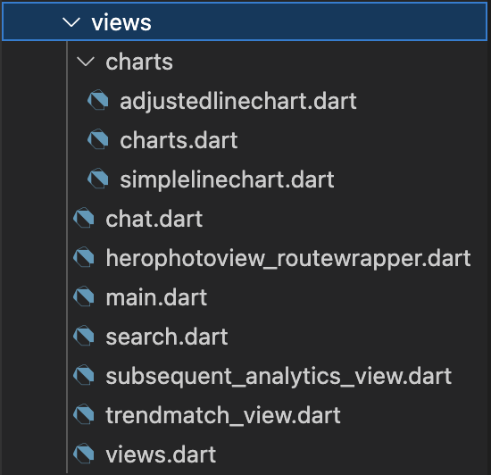
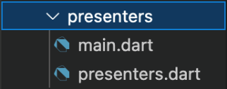
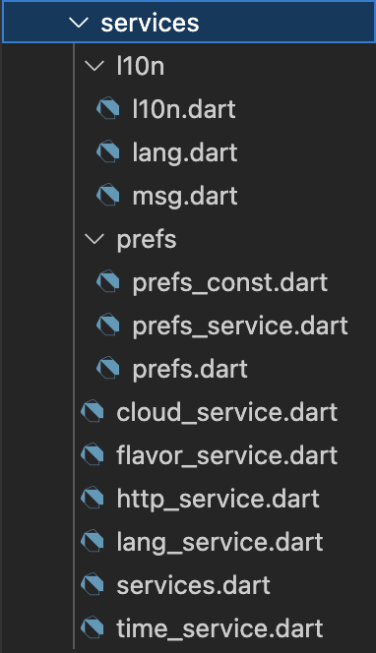
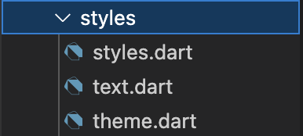
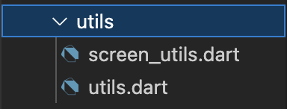
Project structure

Slide 18
Software hardware architectural
Minimum requirement:
Recommended requirement:
OS | Android | iOS
Version | 7.0 | 12
Hardware | Screen size: 5-inch 1080p 441ppi
Network | Dial-up at 500 Kbps, possible with some performance loss (4G)
OS | Android | iOS
Version | 12.0 | 16.1
Hardware | Screen size: 6.69-inch 2796×1290 460 ppi
Network | Dial-up at 1 Mbps, possible with some performance loss (5G)

Slide 19
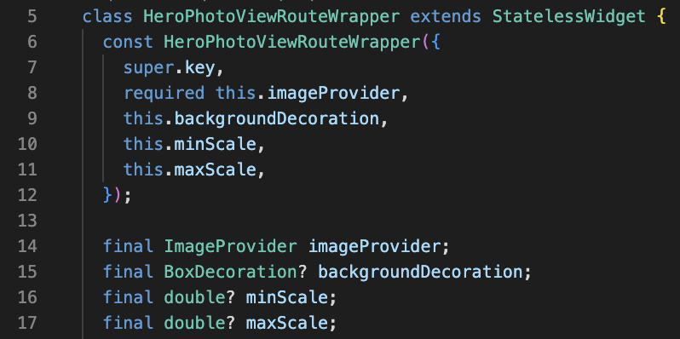
Software design patterns Used
Parameter objects
(one of the example)

Slide 20
Software design patterns Used
Parameter objects
Adapters
Singletons

Slide 21
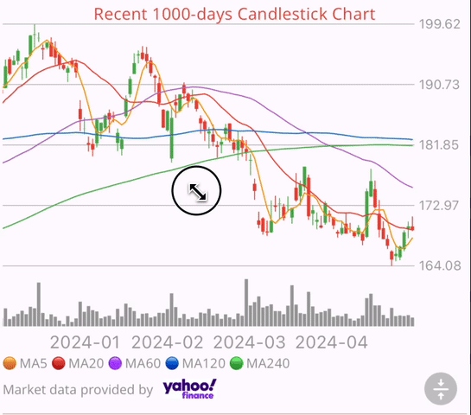
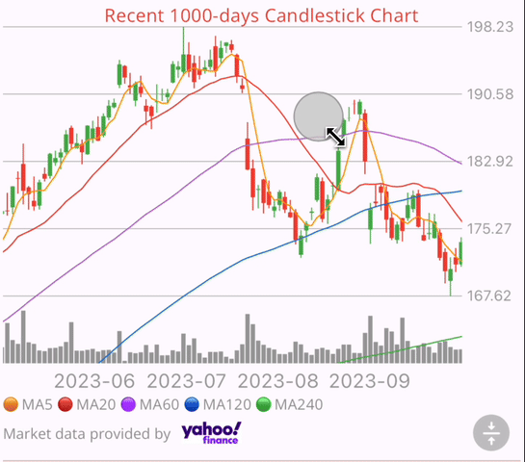
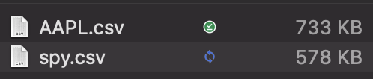
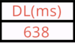
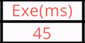
Candlestick chart
Flutter interactive_chart package
Data from Yahoo Finance
https://query1.finance.yahoo.com/v7/finance/download/$stockSymbol?
period1=$startTimestamp&period2=$endTimestamp&interval=1d
&events=history&includeAdjustedClose=true
Check if current UTC time is greater than or equal to 20:00
in Eastern Daylight Time (USA summer and spring seasons)
Check if current UTC time is greater than or equal to 21:00
in Eastern Standard Time
→CSV →List<List<dynamic>> →List<CandleData> by adapter
Support:
Pan
Pinch-to-zoom
Overlay
Hide the overlay line (in developer mode)

Slide 22

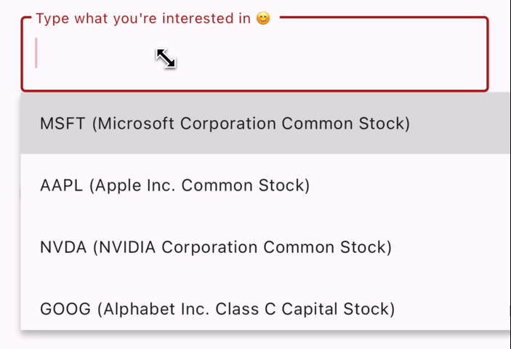
Listings from exchanges
Data from Nasdaq, NYSE, NYSE Amex
Stocks:
https://api.nasdaq.com/api/screener/stocks?tableonly=true&limit=99999&exchange=NASDAQ
https://api.nasdaq.com/api/screener/stocks?tableonly=true&limit=99999&exchange=NYSE
https://api.nasdaq.com/api/screener/stocks?tableonly=true&limit=99999&exchange=AMEX
ETFs:
http://35.221.170.30/?func=nyse-etfs-symbol-name
→text/json →List<SymbolAndName> by adapter
We have these listings to support our search utility

Slide 23
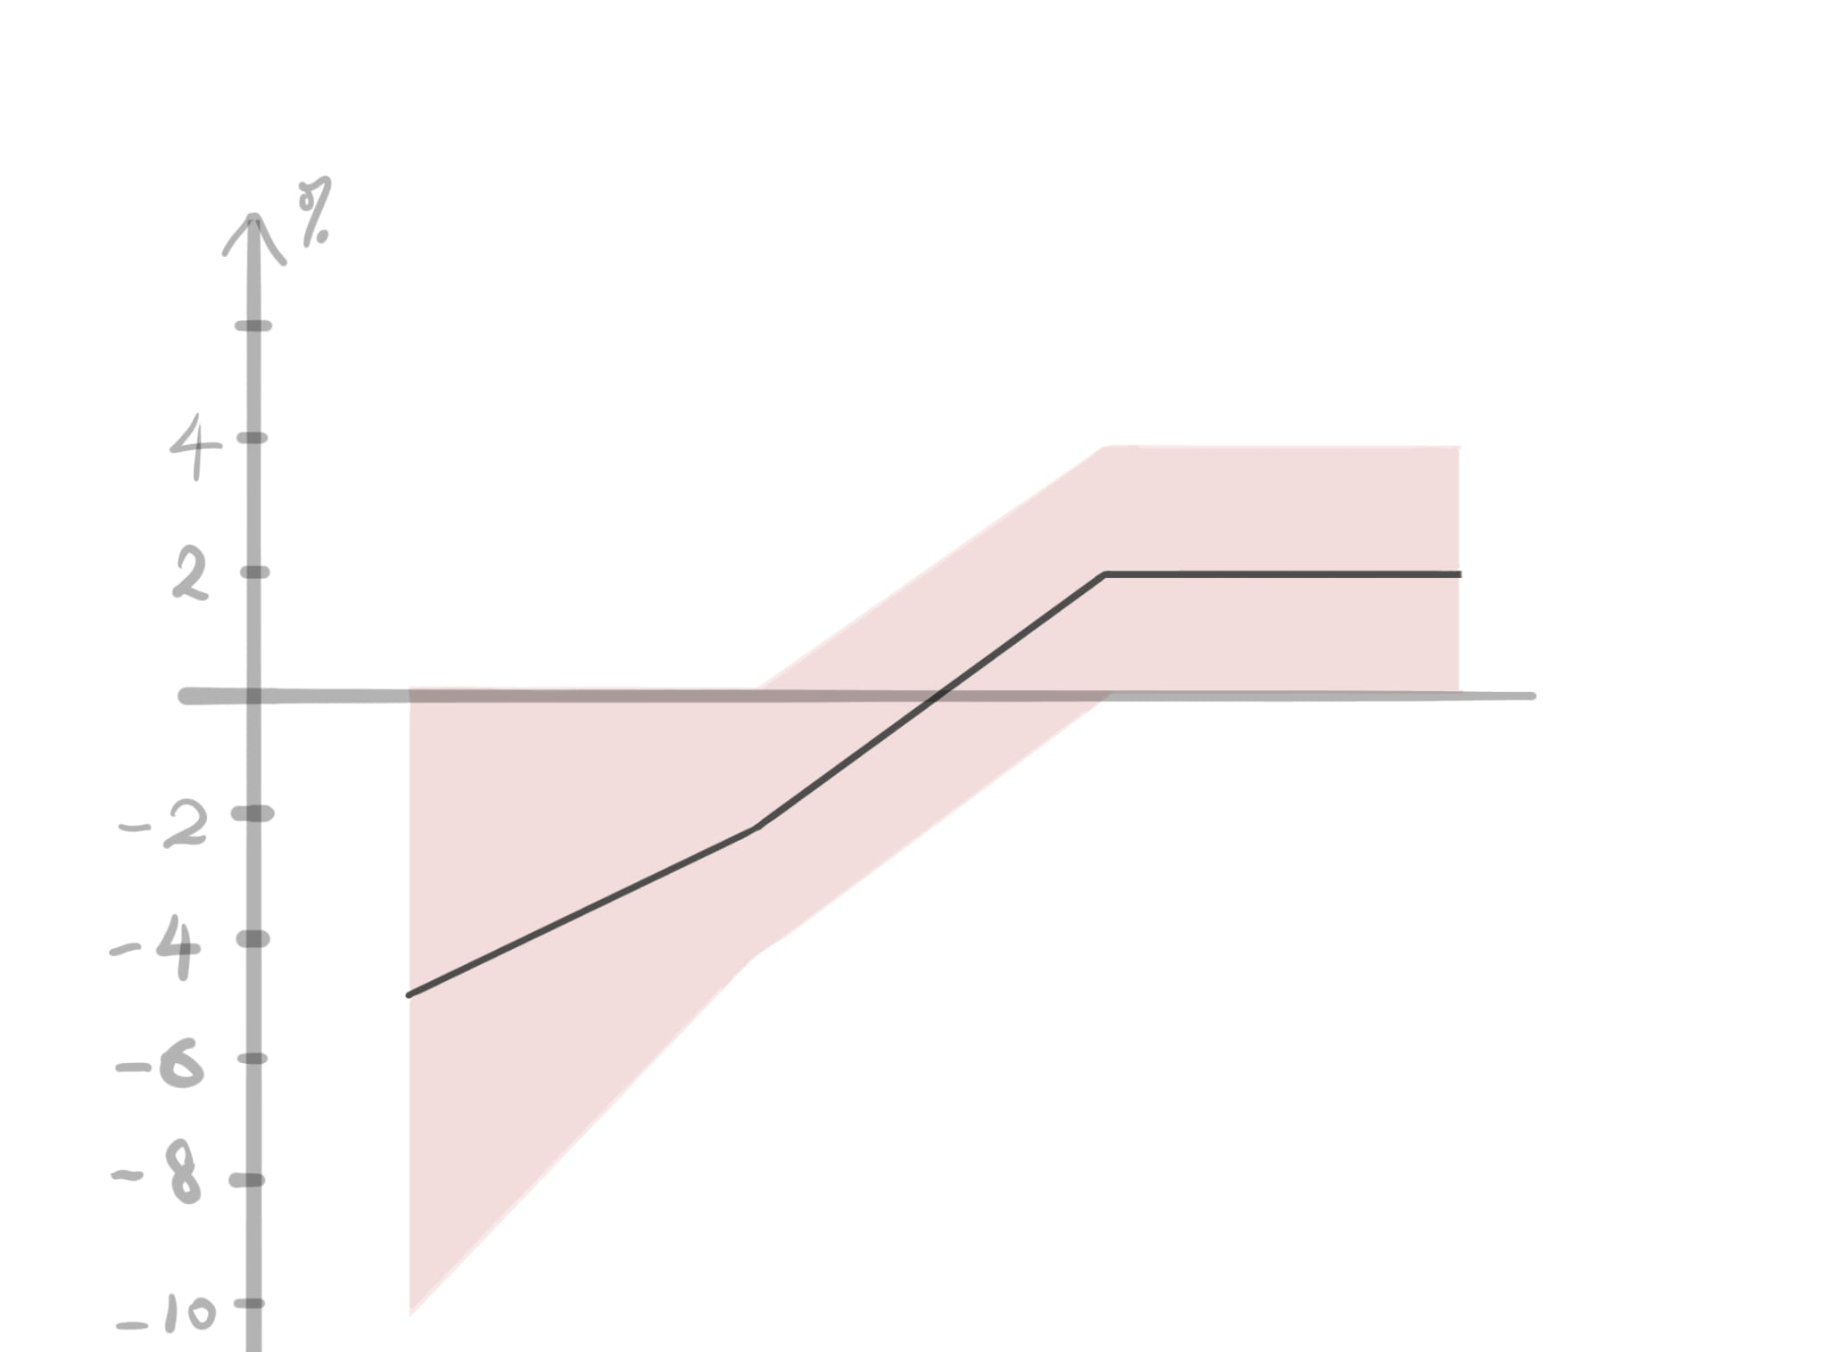
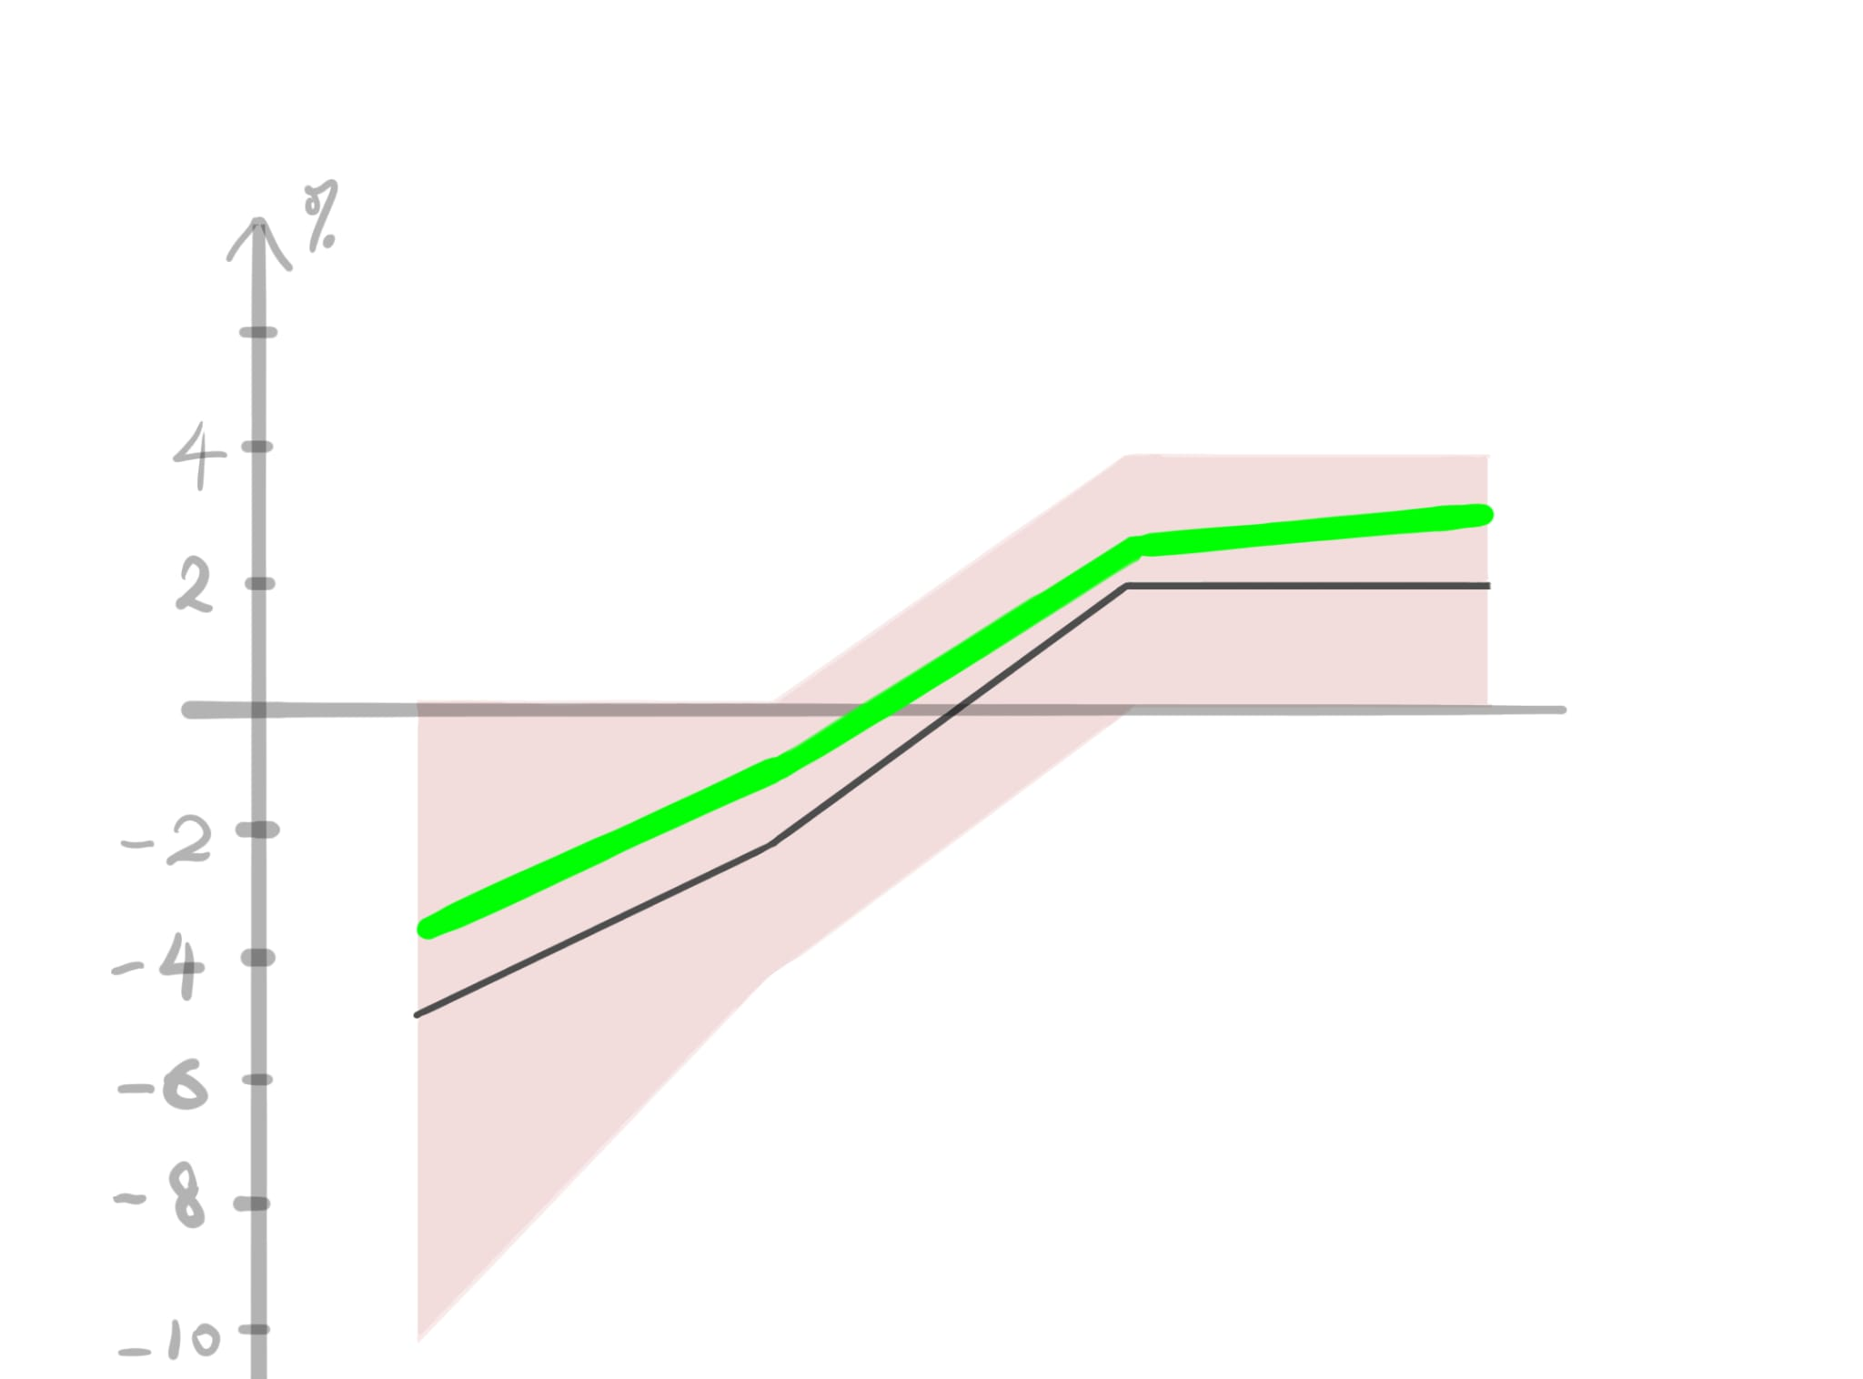
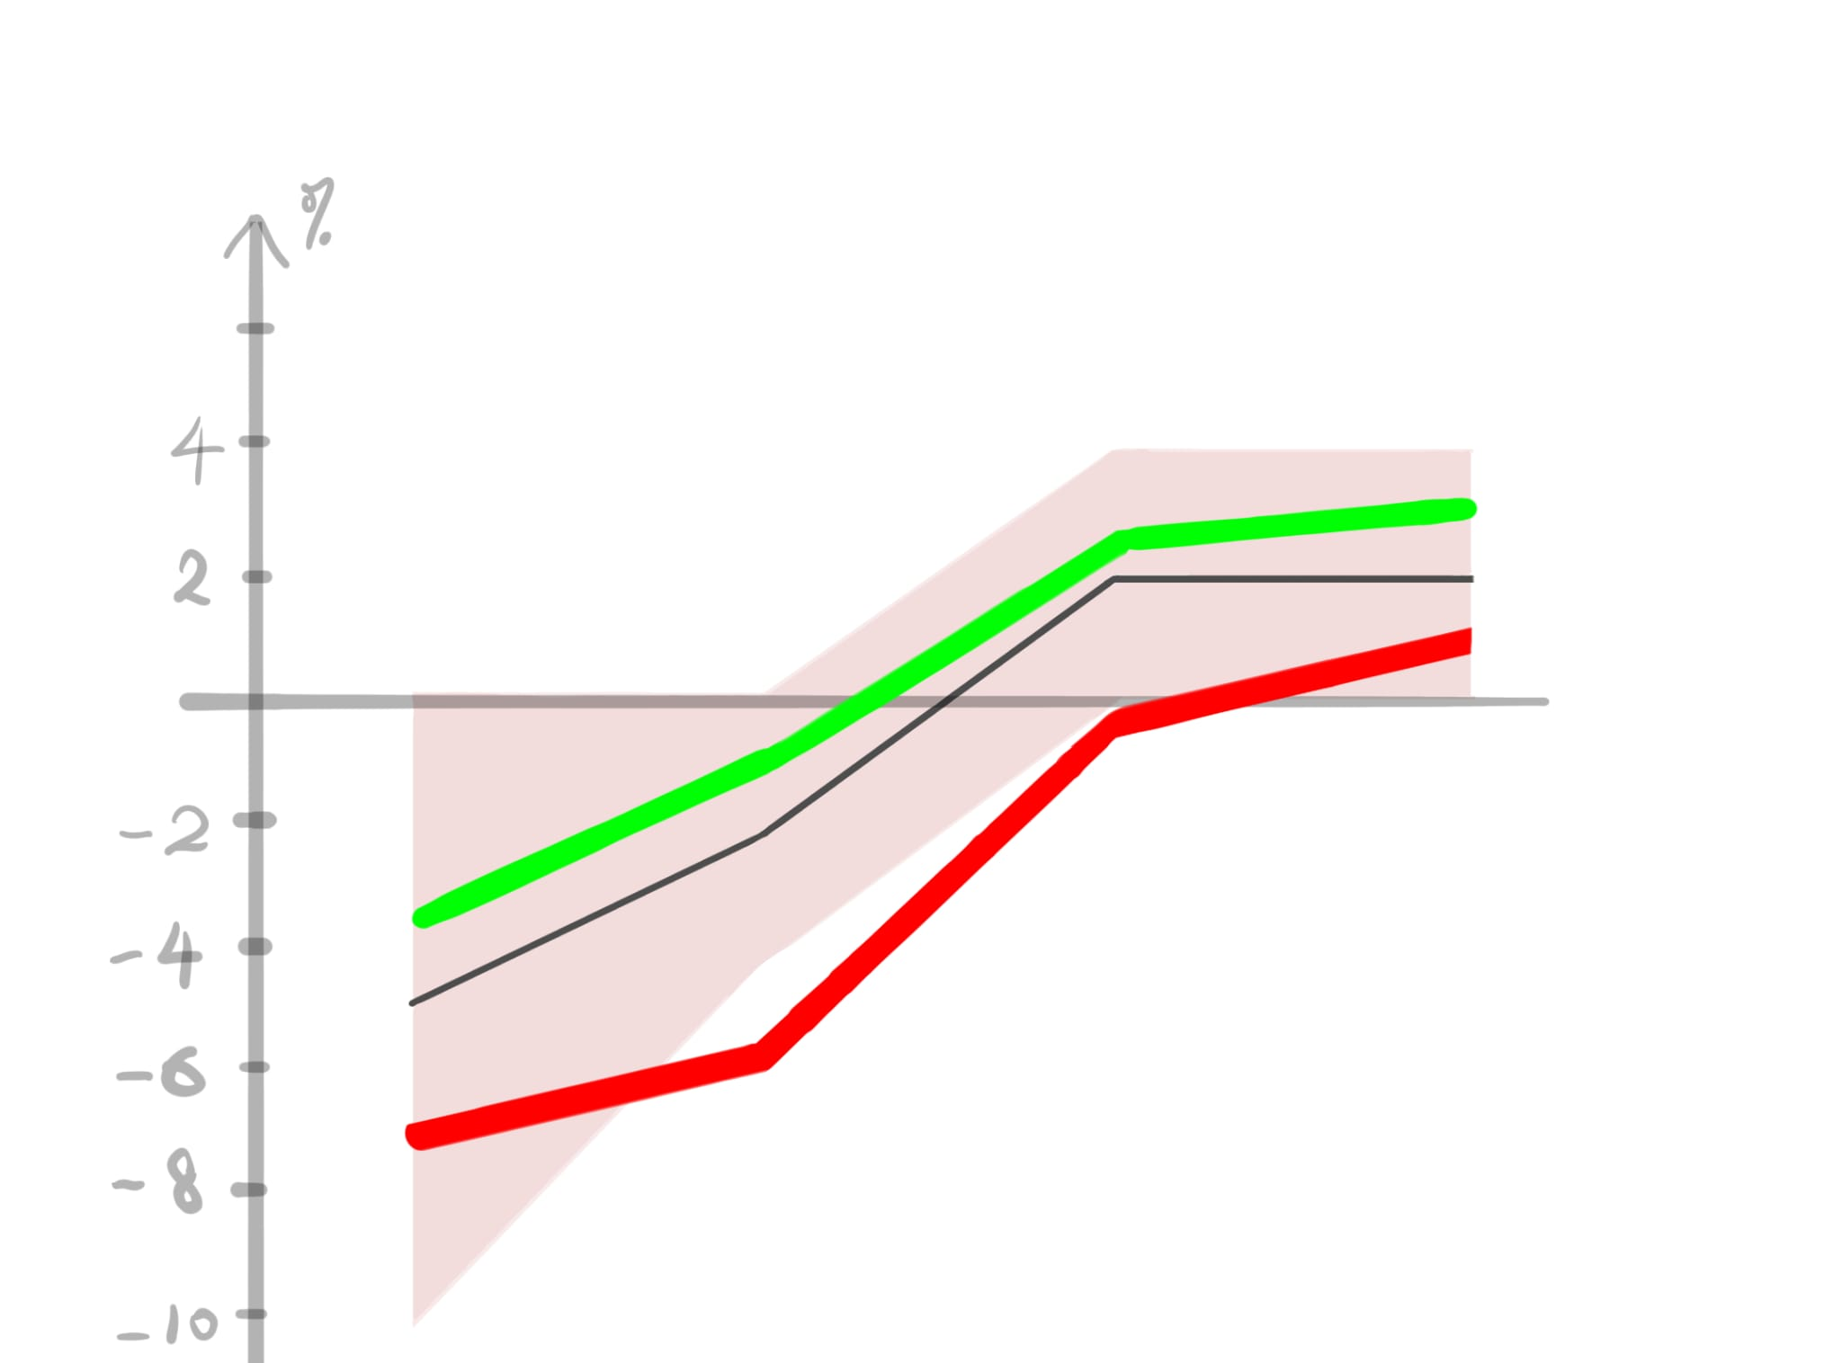
Trend matching (method)
Identification of matched trend:
Selected last 5 days stocks
Calculate the daily difference between the close price
The close-price-differences compose a time series like [-5%, -2%, +2%, +2%]
Look for all similar trends in the history of this stock
Pseudo code:
For selected date
Calculate the percentage change of closed price between the date and the next date (selList)
For every date in the history except selected date
Calculate the percentage change of closed price between the date and the next date (comList)
For comList
Calculate the percentage difference between selList and comList for 5 times(selected days) (pd)
If all pd < 100% (Tolerance)
Match trend + 1
else
Not Match trend + 1
Match
Not match

Slide 24
Trend matching (method)
initialize empty lists for selected and compare periods
if init is true
for each selected data point
calculate percentage difference, actual difference, actual price, add them to respective selected lists
update selected lists in the MainPresenter
for each data point
calculate percentage difference, actual difference, actual price, add them to respective compare lists
compare percentage difference between the selectedPeriodPercentageDifferenceList and the comparePeriodPercentageDifferencesList (pd) within day range (default:5)
if all pd < Tolerance
comparisonResult = comparePeriodPercentageDifferenceList
if the comparisonResult is true
increment trueCount
add the comparisonResult to the match lists
update compare period lists and match lists in the MainPresenter
Match
Not match
Notes:
Calculate the percentage difference between selectedPeriodPercentageDifferenceList and the comparePeriodPercentageDifferencesList within day range (default: 5) (pd)
If all pd (total: 5) < Tolerence (default: 100%)
comparisonResult = comparePeriodPercentageDifferencesList
Matching Trend ++
add comparisonResult to matchPercentageDifferenceListList Reference only

Slide 25
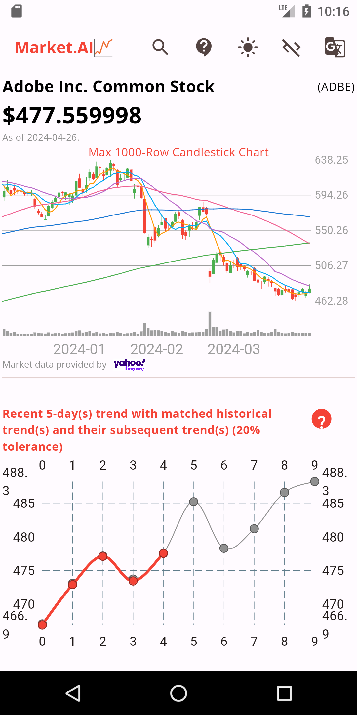
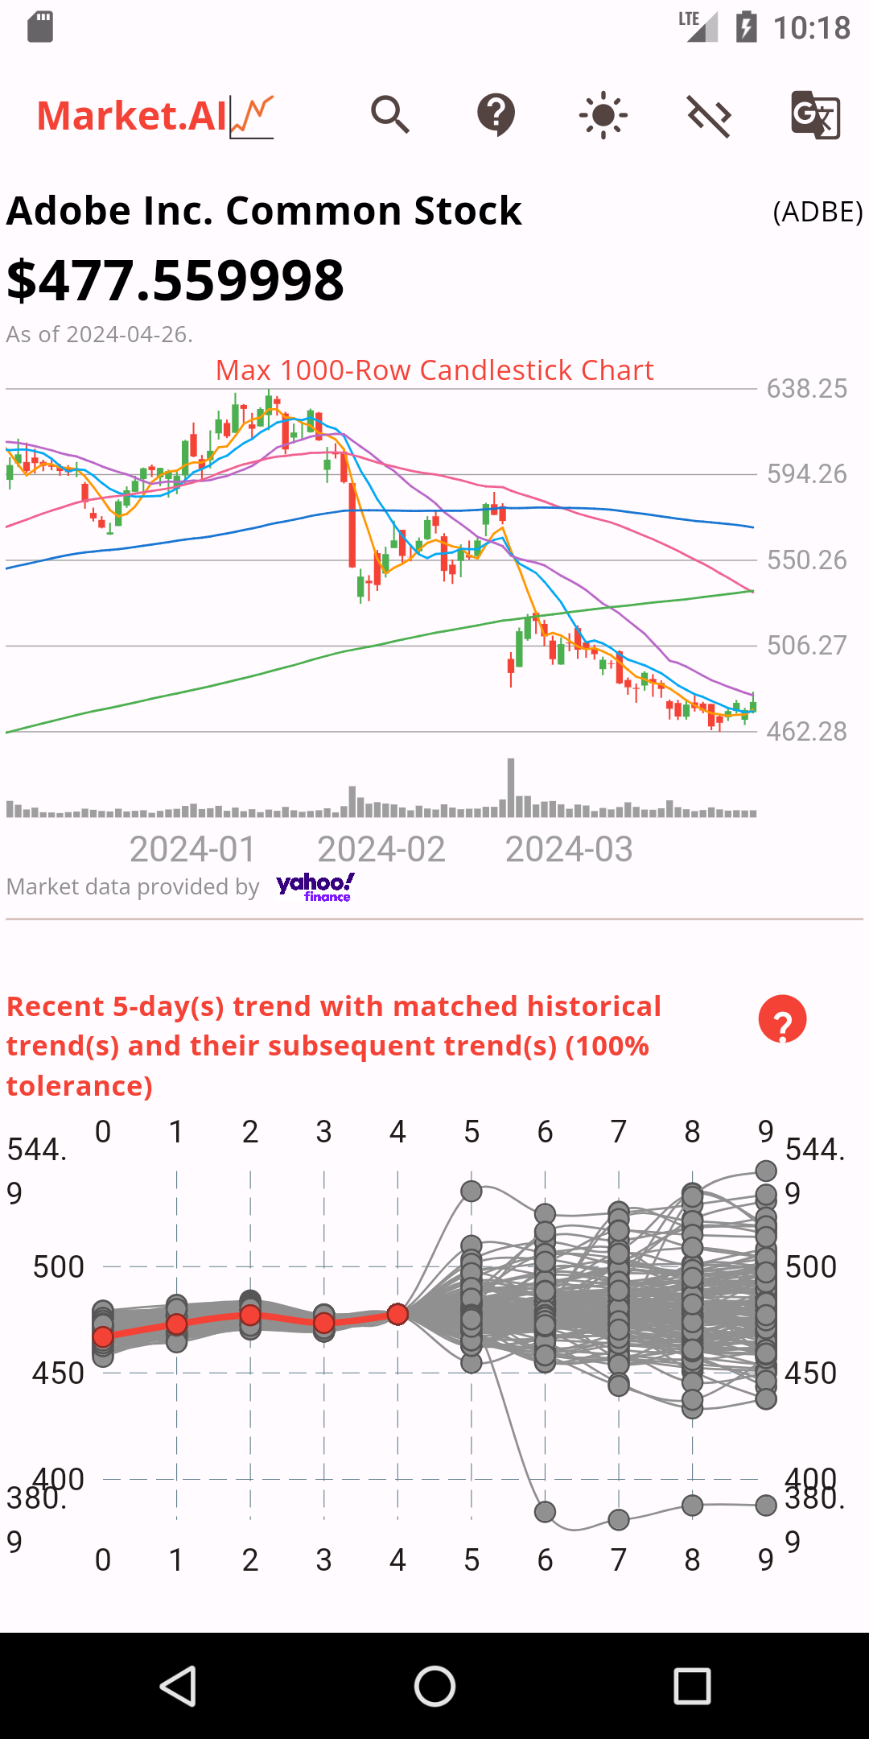
Trend matching (result)
Challenge: ​
How similar (by %) = matched?
Tolerance: the deviation from the daily difference time series
e.g., tolerance = 20%
[-5%, -2%, +2%, +2%] is matched with
[-6% ~ -4%, -2.4% ~ -1.6%, +1.6% ~ +2.4%, +1.6% ~ +2.4%]
Problem: inadequate match cases due to small tolerance
Solution: enlarge the tolerance to 100%
e.g., tolerance = 100%
[-5%, -2%, +2%, +2%] is matched with
[-10% ~ 0%, -4% ~ 0%, 0% ~ +4%, 0% ~ +4%]

Slide 26
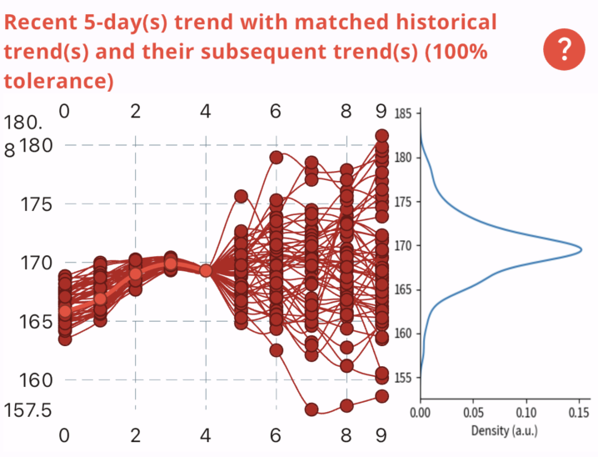
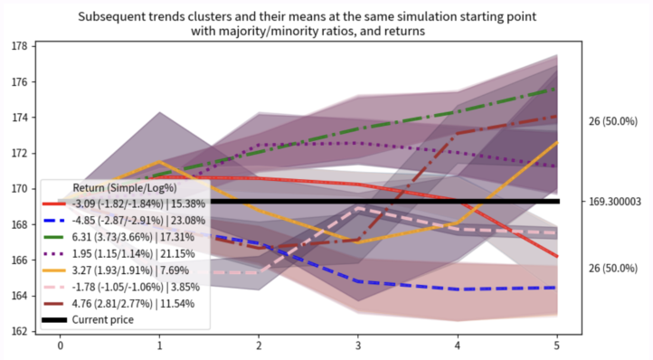
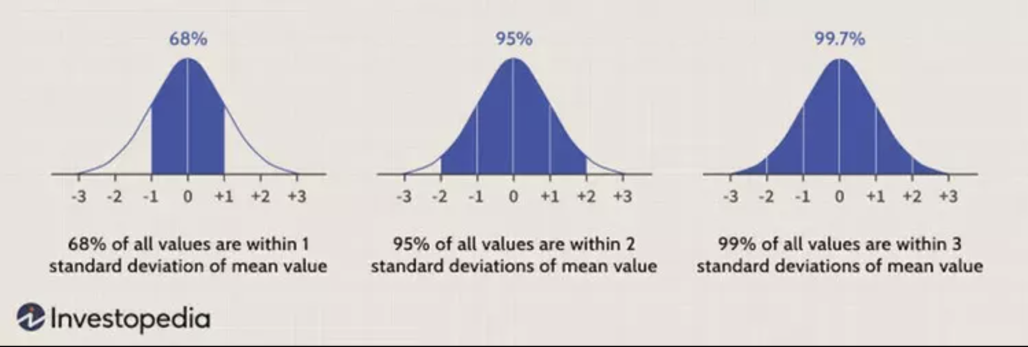
Subsequent trend analysis - objective
Three types of analysis:
Expected return by mean/median (by close price only) – center of the last day
Distribution with mean and +/- std (by close price only) – spread / shape of the last day (Applied 'The Empirical Rule')
Trend clustering (knowing main trends) – hidden main pattern of the time series
More informative
User can easily understand the main trends in complex trend distributions and why they are so similar, and they can easily determine which cluster fits the Subsequent trend.

Slide 28
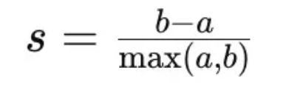
Subsequent trend analysis – clustering
Chart 1-2: elbow (a good vs poor case, to show it is not clear)
[Joyce]Clustering algorithm implementation
K means
What K?
Elbow
Sometimes the elbow is not clear (intra distance only)
Elbow position is subjective
Silhouette Coefficient
b is inter cluster distance
a is intra cluster distance
Consider both inter and intra distance
Always an max value
The weighting between b and a is subjective ( we use 1 and 1 here)
Chart 3: SS (a case to show it has an optimal value)

Slide 29
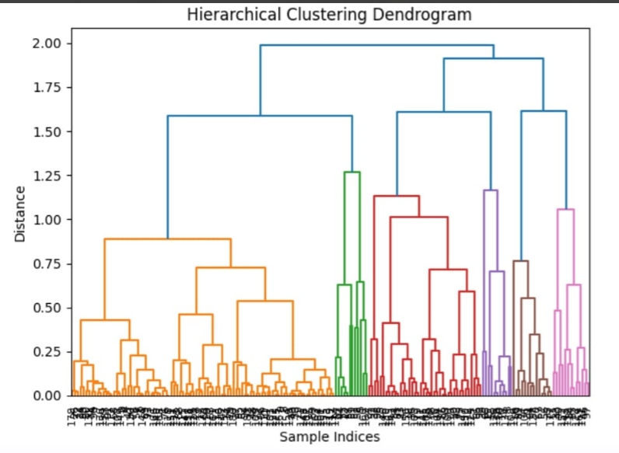
Subsequent trend analysis – clustering effect
[Joyce]Clustering algorithm implementation
HAC
Correlation based
Principle
Explain this chart
How many pairs should we use after calculation ?
(next page -- solution)

Slide 30
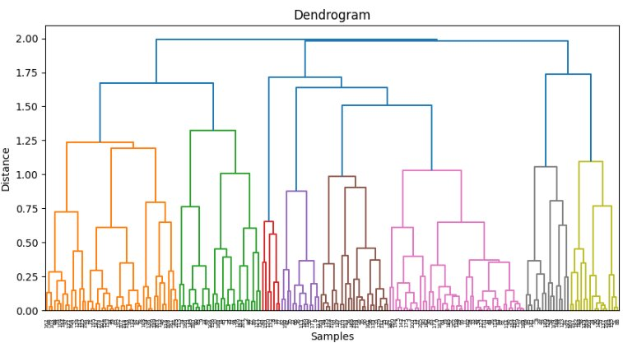
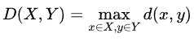
Subsequent trend analysis – time series clustering
Clustering algorithm implementation
HAC (Hierarchical Clustering)
Complete Linkage Clustering
Correlation based
𝑥 and 𝑦 are the most distant elements in X and Y respectively
Bottom-up approach
Each data represent one cluster → a single cluster
How many pairs should we use after calculation ?
(next page -- solution)

Slide 31
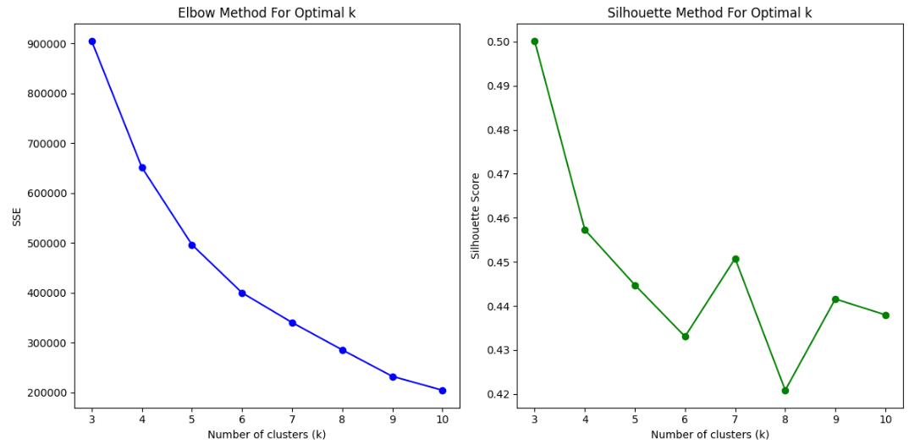
Subsequent trend analysis – how many clusters?
How many clusters?
Elbow
Sometimes the elbow is not clear (intra distance only)
Elbow position is subjective
Silhouette Coefficient
b is inter cluster distance
a is intra cluster distance
Consider both inter and intra cluster distance
There is always a max value
The weighting between b and a is subjective ( we use 1 and 1 here)

Slide 32
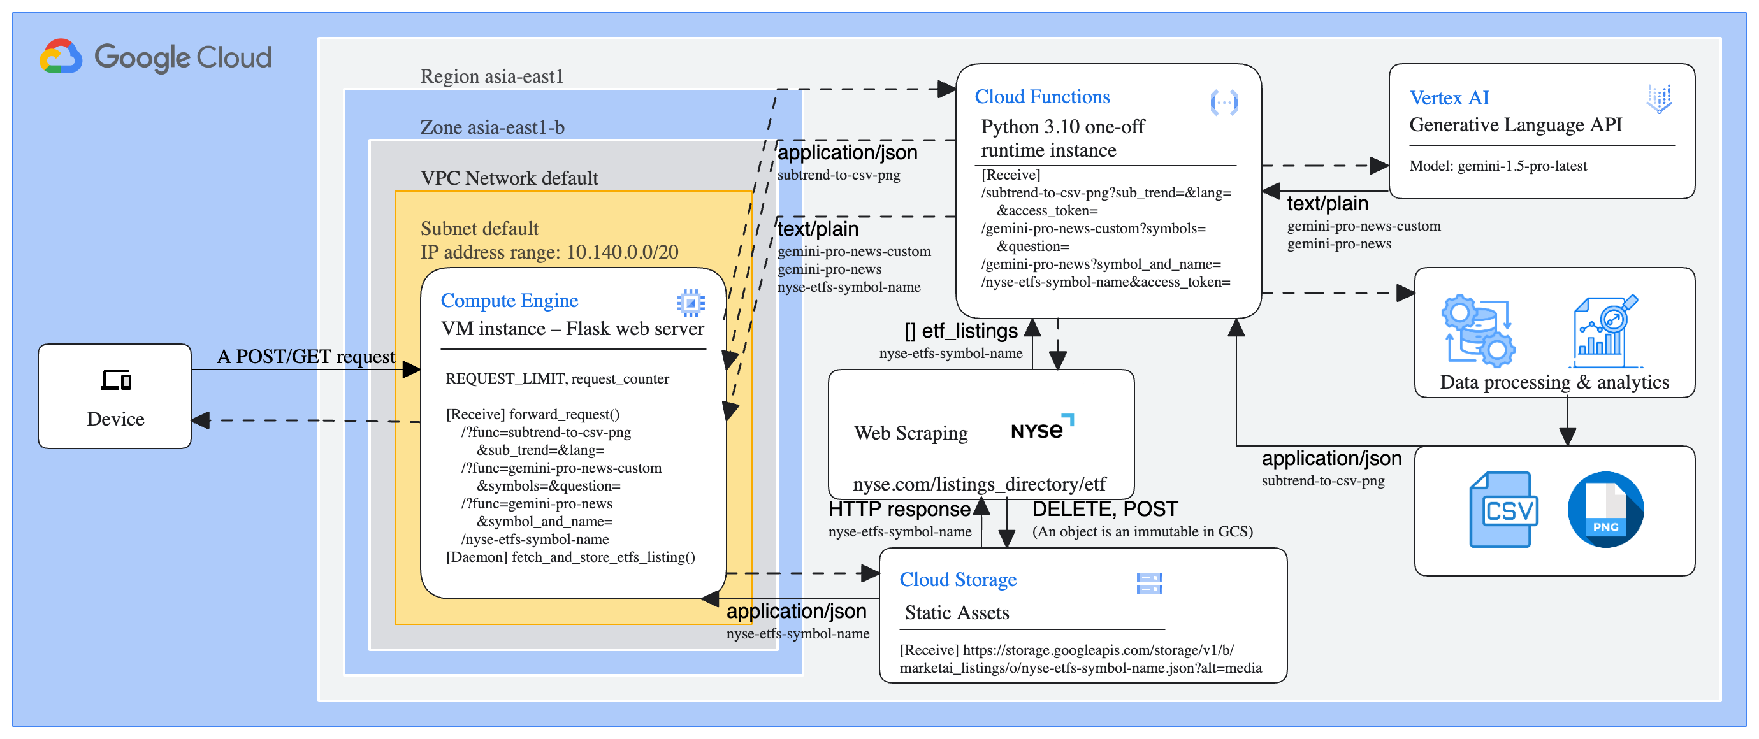
Subsequent trend analysis – cloud functions
Clustering involves intricate computational processes that are not feasible to execute on the client side of an application. This is particularly true for Flutter, as it lacks packages for data mining and visualization.

Slide 33
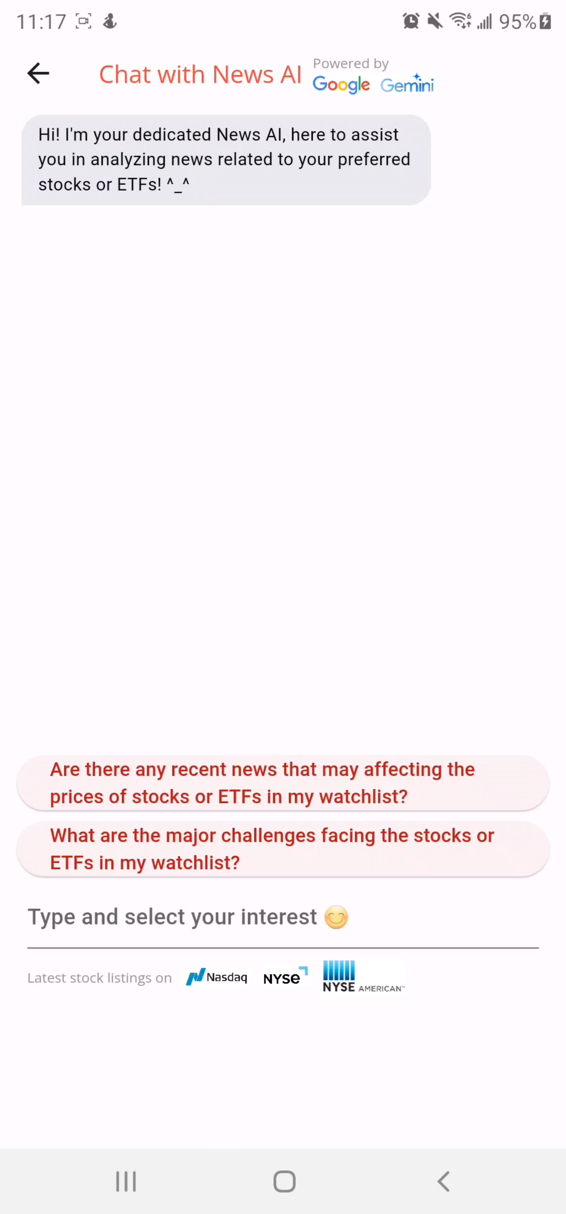
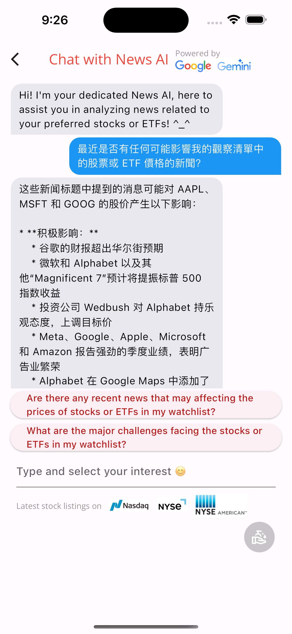
Generative AI aided news provider
Reporting related news of financial instrument:
Using GNews package, summarize a kinds of news from the entire internet, but we fine-tune it for our financial usage by Gemini Pro 1.5
In _ChatViewState class
_sendMessage method -> sending message to the Cloud Function
adding the message to the list of messages, updates the scroll position, and retrieves news analytics based on the message using the CloudService class
Cloud Function make API calls [Generative API] & retrieve data
aiResponseTime -> storing calculated response time of AI service

Slide 34

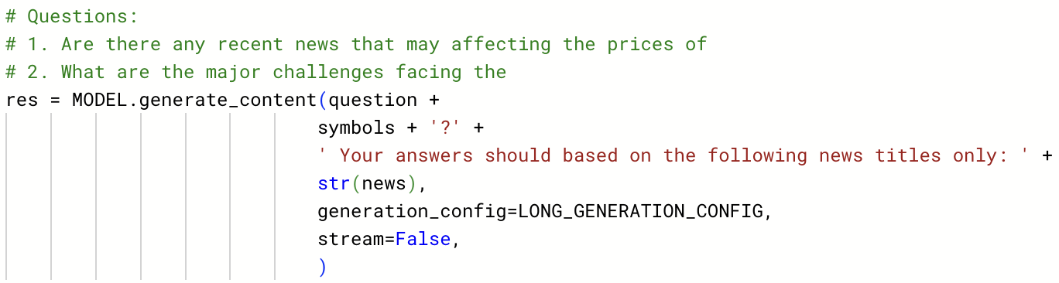
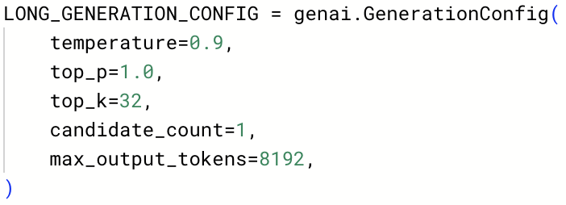
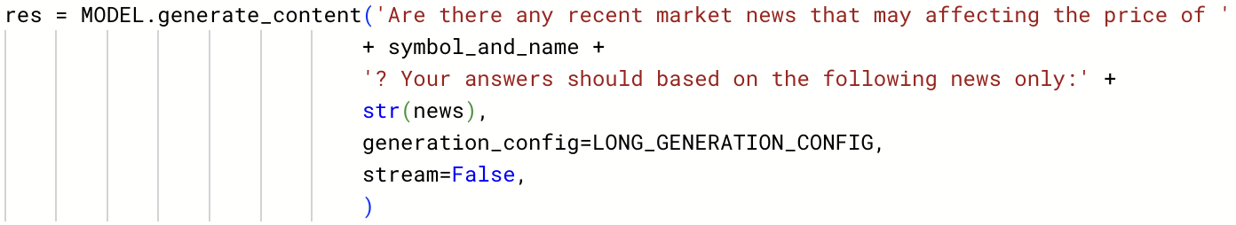
Generative AI aided news provider
❌
❌
❌
/gemini-pro-news-custom
temperature (0.1): Controls randomness in output. Lower = more deterministic.
top_p (1.0): Sets threshold for cumulative probability for word selection.
top_k (32): Limits next word selection to top K probable words.
candidate_count (1): Number of sequences generated before final output.
max_output_tokens (32): Maximum length of generated sequence.
/gemini-pro-news

Slide 35
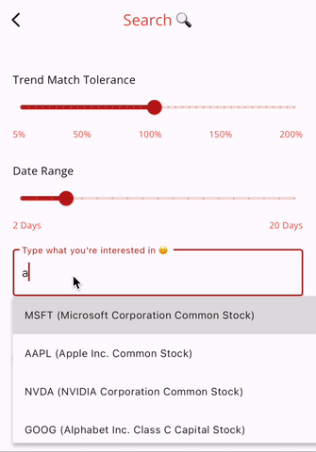
Customized search
Allowing users to input the preferred date range, tolerance and stock
Generating graphs & data for users
_displayStringForOption for formatting the display string for autocomplete options (Entering stocks name & symbol)
_resetForm for resetting the search form
_submitForm for submitting the search form and performing validations
using the Get package and shared preferences (PrefsService) for storing and retrieving user preferences temporarily or permanently
updating the UI

Slide 36
Customized search
Search Function:
Input tolerance, date range, stock -> submit -> updating the UI
Define variables:
_currentTolerance: Numeric variable to store the current tolerance
_currentRange: Numeric variable to store the current date range
_textEditingController: Text input controller for the search field
_autocomplete: Boolean variable to indicate if autocompletion is enabled
listSymbolAndName: List variable to store symbol and name data
Define methods:
_displayStringForOption: Generate a display string for a given option
_resetForm: Reset the form and set state variables to default values
_submitForm: Handle form submission and update the main page
Autocomplete widget:
optionsBuilder: Returns the current selectable options based on user input
OnSelected: Handle selection of an autocomplete option by user

Slide 37
Generative AI aided news provider
startMessage method
|
|--- send message to the Al service
| |
| |--- CloudService class (Gemini API)
| | |
| | |--- Make API call to Gemini API
| |
| |--- CloudService class (GCP)
| |
| |--- Retrieve data via CloudService class (GCP)
|
|--- Add message to the list of messages
|
|--- Update scroll position
|
|--- Retrieve news analytics based on the message
|
|--- CloudService class (Gemini API)
|
|--- Make API call to Gemini API
--- Store calculated response time of Al service (aiResponseTime)
Reporting news of related stocks:
App send out [question, args…]
Cloud (VM)
Using GNews package
Gemini
Training/prompts: e.g.,
Cloud function sends back the new summary
Displaying news based on stocks’ name / symbol that user typed
Watchlist details

Slide 38
Analysis & test cases
05

Slide 39
Subsequent trend analysis
Tolerance/ Days | 50% | 100% | 120%
2 Days | 1112 | 1993 | 2695
5 Days | 5 | 71 | 170
10 Days | 0 | 2 | 9
Stock ticker: AAPL
Number of matching trends with various tolerances and trend-matching windows
Observation：
Fix the tolerance: longer trend-matching window --> fewer matched trends
Fix the trend-matching window: larger tolerance --> more matched trends
Conclusion: the trend matching algorithm functions logically

Slide 40
Subsequent trend analysis
AAPL
Number of matching trends
Histogram here
Number of matching trends
Tolerance

Slide 41
Subsequent trend analysis
# of clusters
Randomly picked 30 stocks with
tolerance = 100%
trend-matching window = 5 days
1 cluster is not allowed in the clustering stage
The user can see it without clustering
2-3 clusters are the most frequent
Informative to the user, a small number of main trends
More than 4 clusters are not often
Not so meaningful to the user to determine the Subsequent trend
Conclusion: 5 days, 100% are a set of good parameters, so we set them as the default

Slide 42
Subsequent trend analysis
# of clusters
Randomly picked 30 stocks …..
Histogram here
Number of clusters

Slide 43
Subsequent trend analysis
# of clusters
Randomly picked 30 stocks …..
This is to show the distribution of the SS score (to tell in most of the cases, whether a high enough SS score exists)
distplot of SS score here
SS score

Slide 44
Subsequent trend analysis
# of clusters
Randomly picked 30 stocks …..
This is to show the distribution of the SS score (to tell in most of the cases, whether a high enough SS score exists)

Slide 45
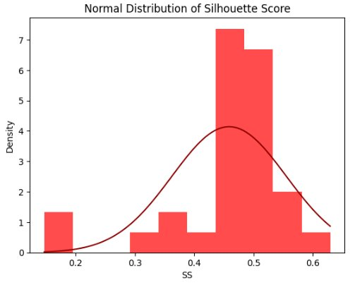
Subsequent trend analysis
Silhouette Score
Randomly picked 30 stocks with
tolerance = 100%
trend-matching window = 5 days
Around 0.5 SS are the most frequent
well-clustered
moderate separation between clusters
Less than 0.3 SS are not often
overlapping clusters or an unclear separation between clusters
Conclusion: Most of the picked # of clusters are with a reasonable Silhouette Score, so the trends are well-clustered

Slide 46
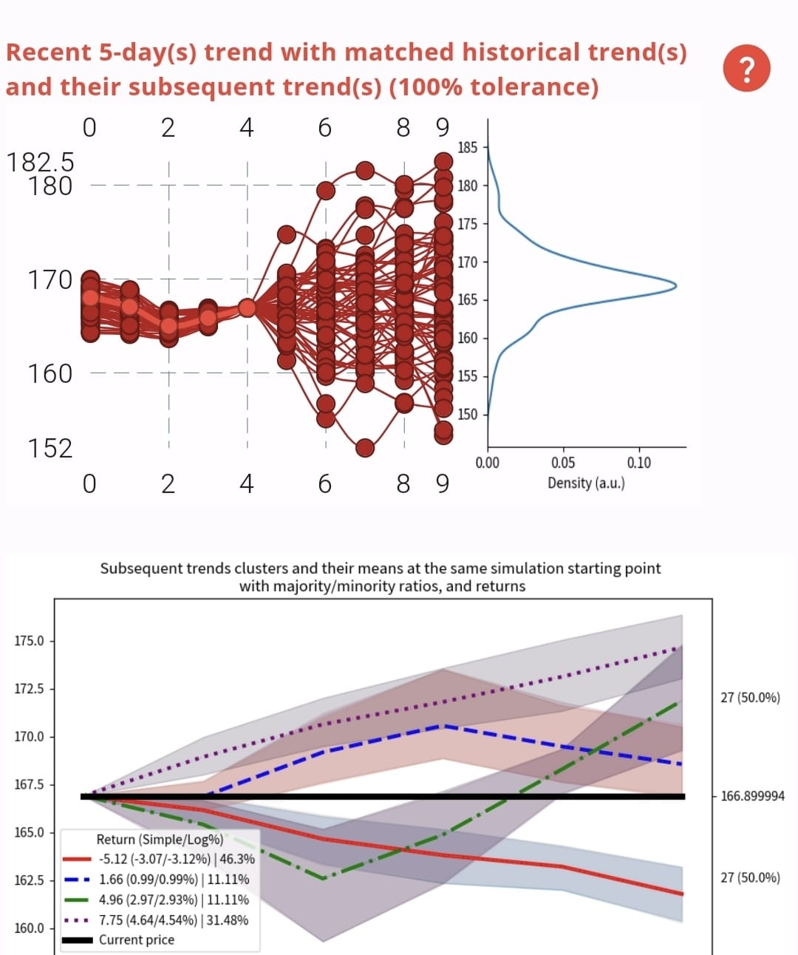
Subsequent trend analysis
Subsequent trend analysis on 4/20 - 4/24
Stock: AAPL
Most of Subsequent trend and actual stock price last day return are positive
The trend of our Subsequent trend analysis in blue dot line is like the actual price
However, the blue dot line trend is not the most likely Subsequent trend
Conclusion: Our Subsequent trend analysis can really provide some useful Subsequent trend to user for reference
Actual stock price on 4/24 - 4/28

Slide 47
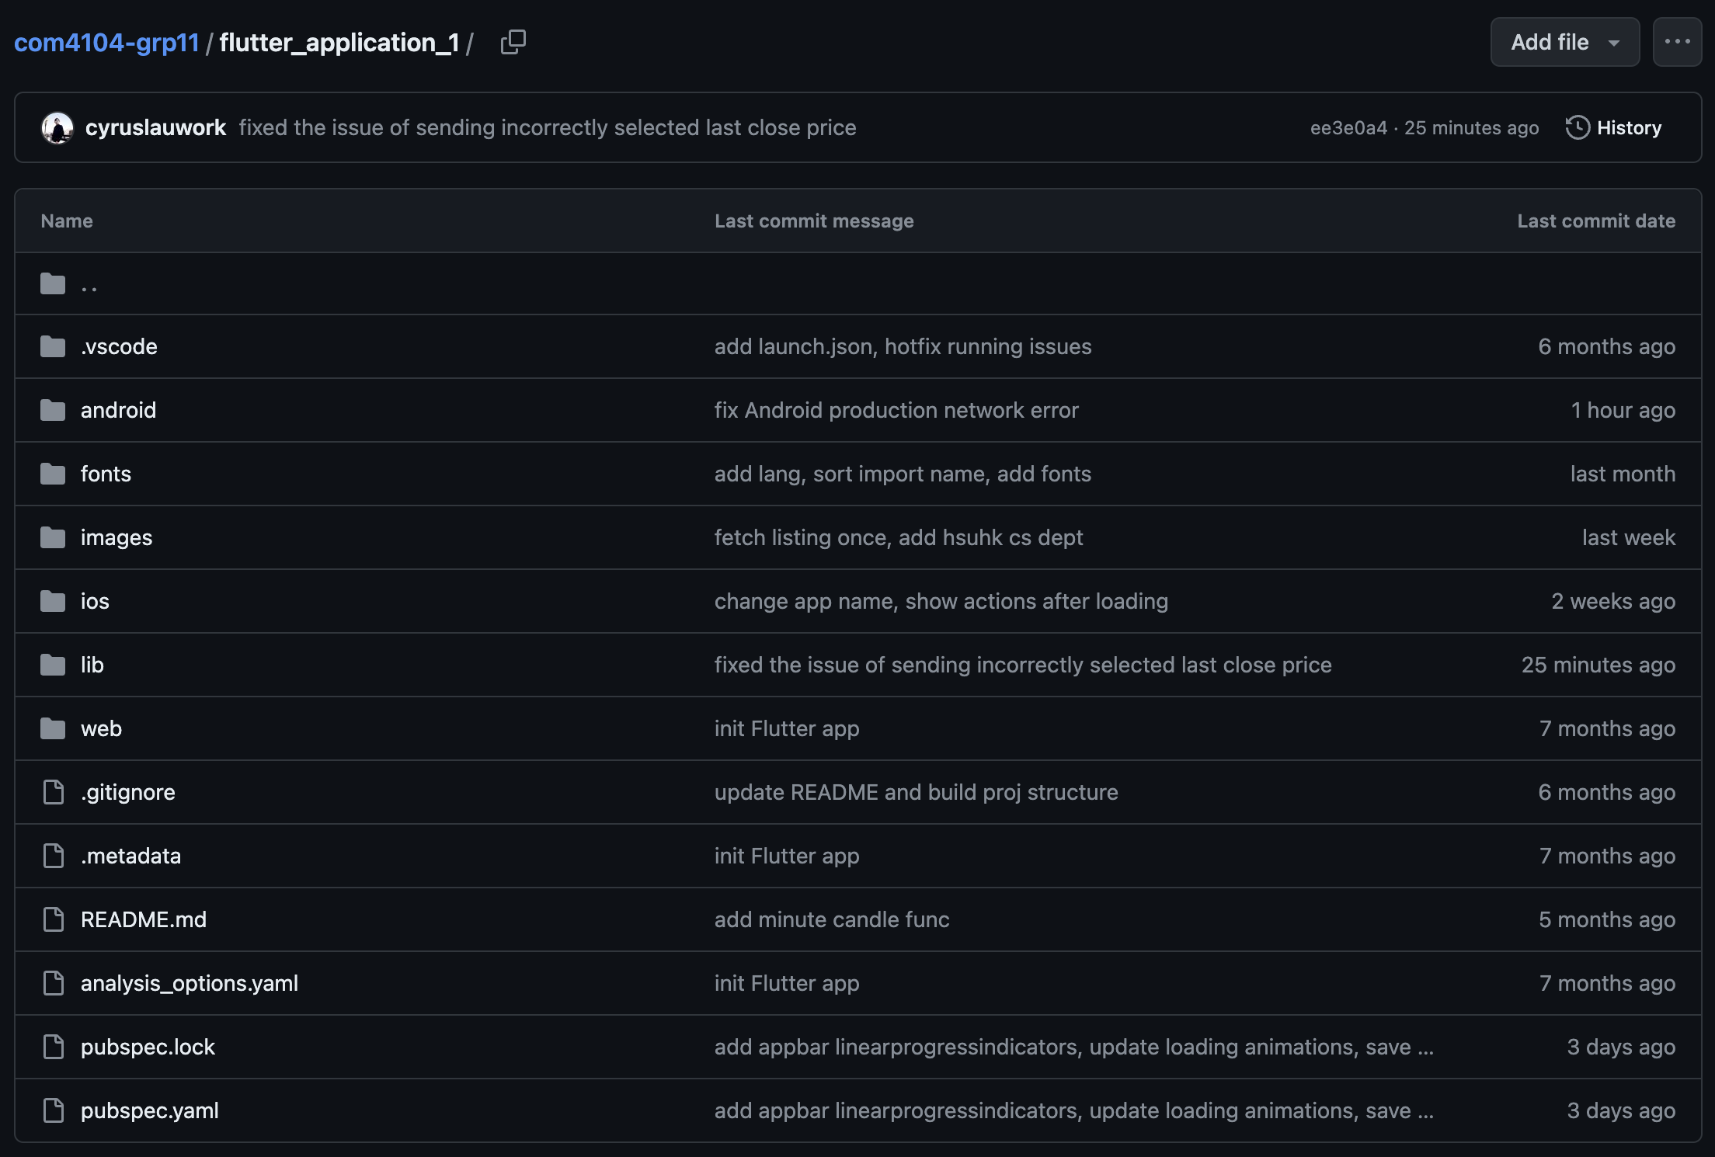


Version control
Powered by Git and GitHub

Slide 48
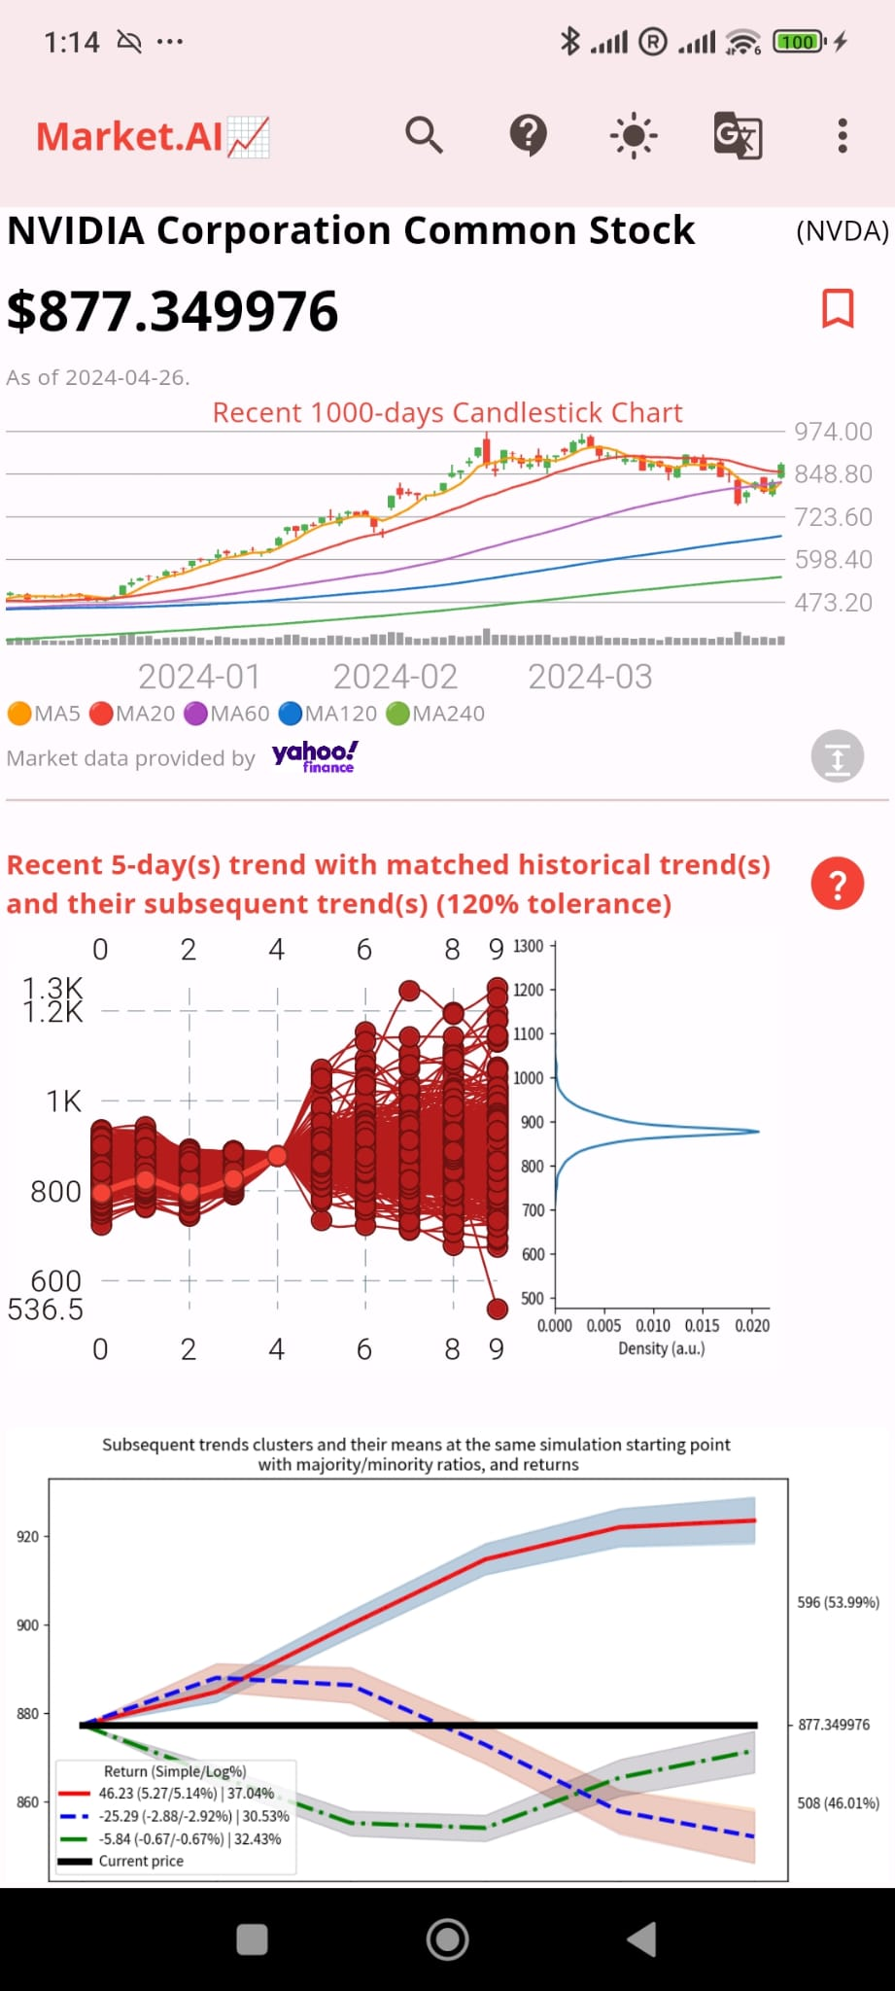
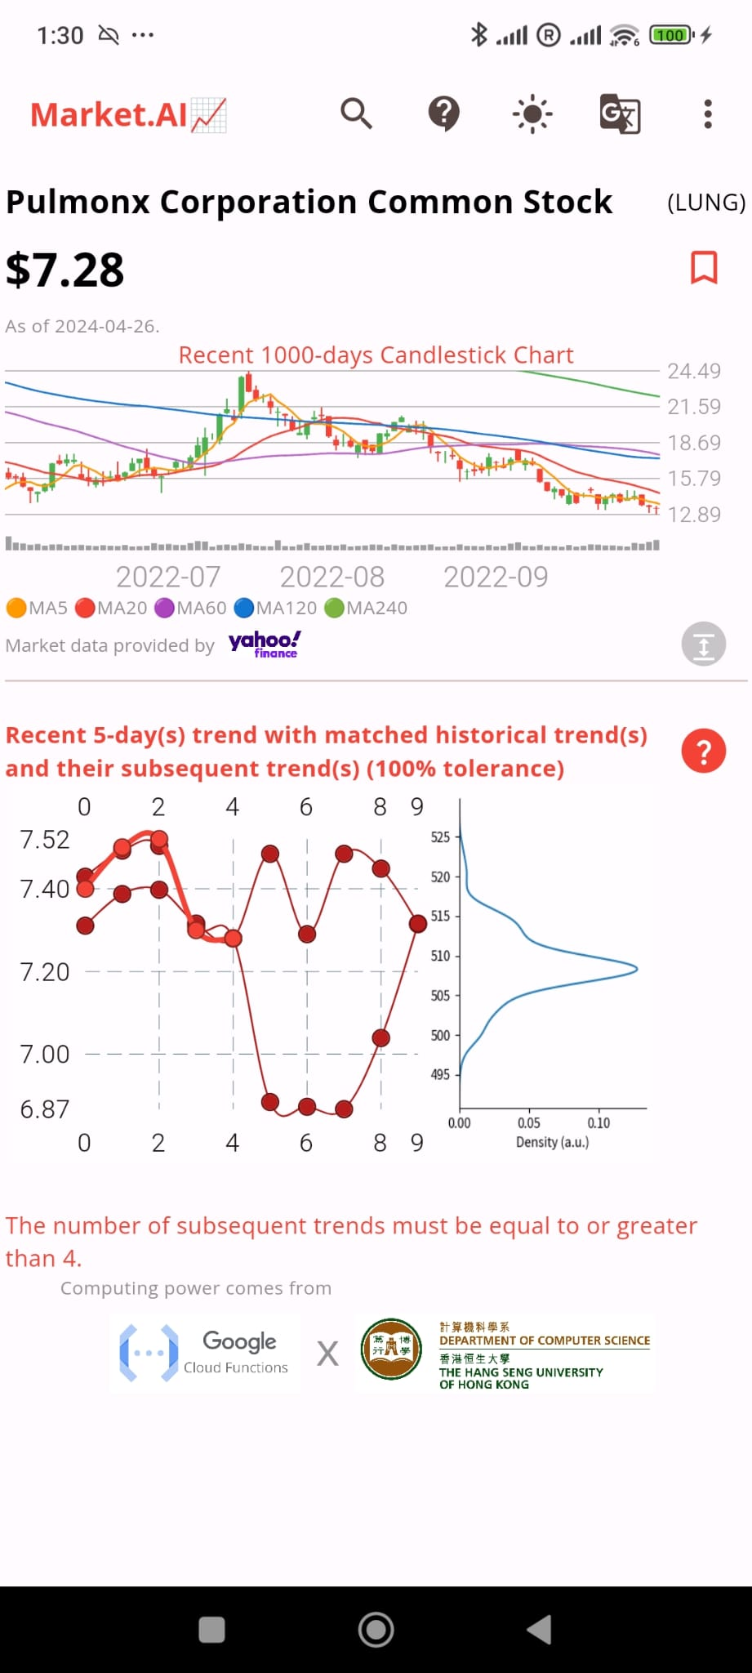
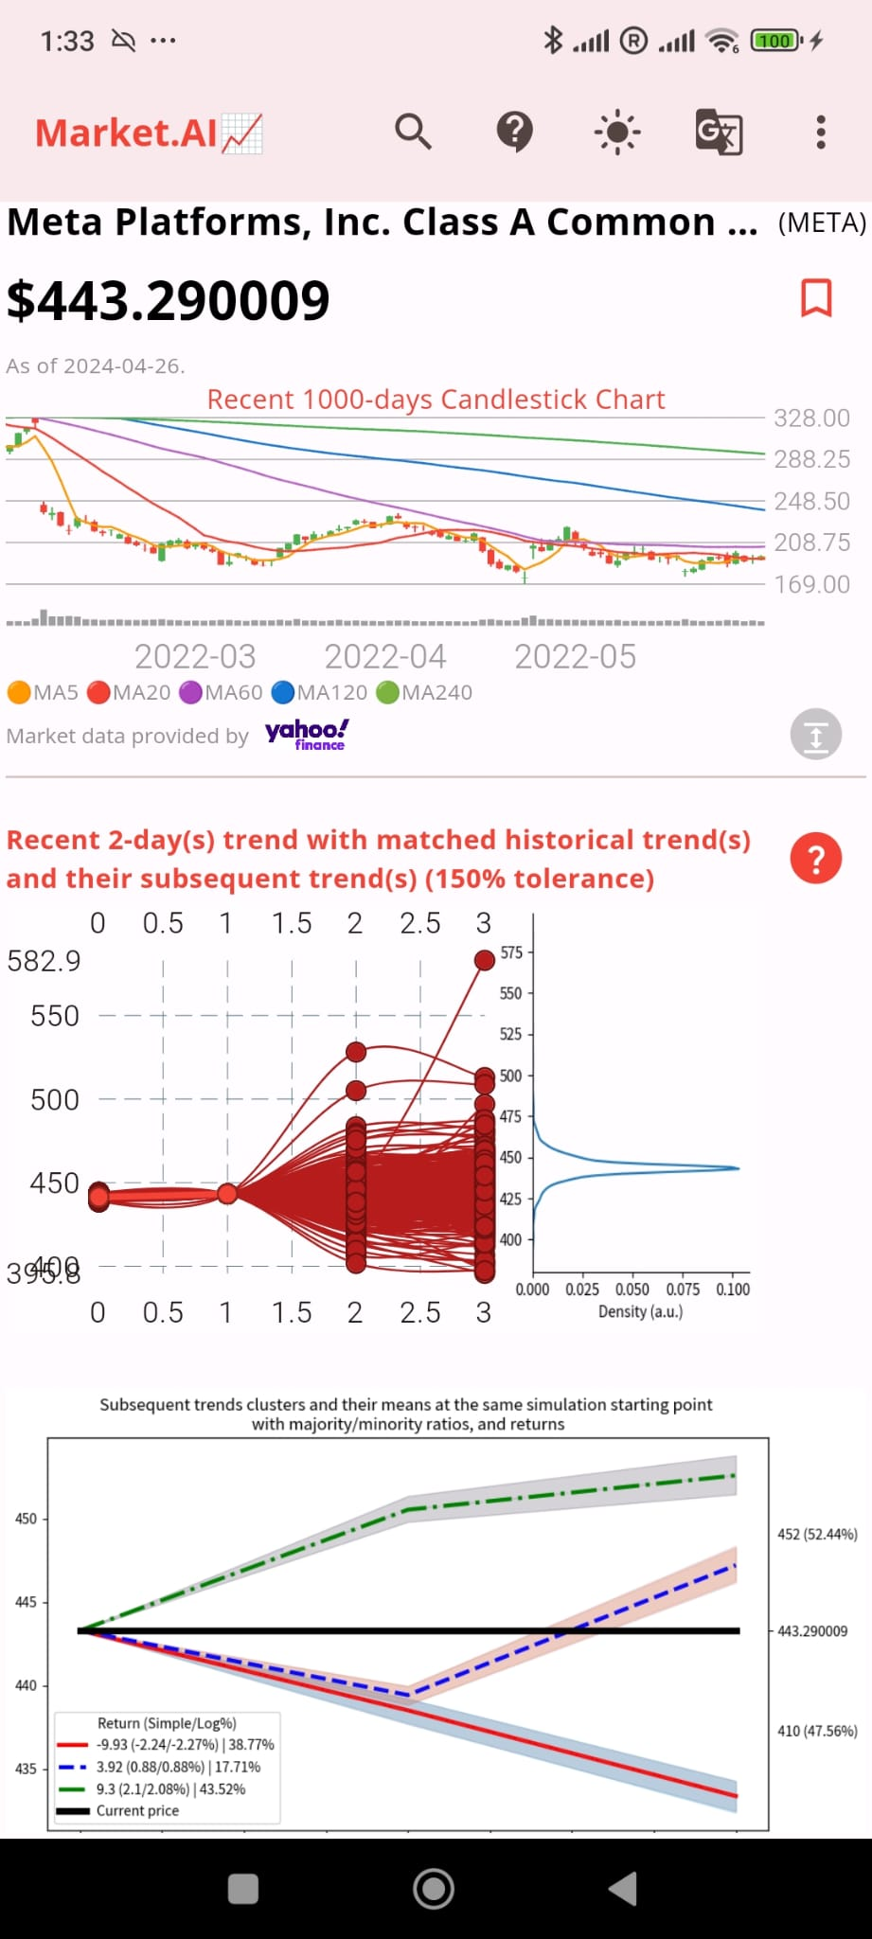

Test cases
Usability
Effectiveness ✔
Efficiency ✔
Satisfaction ✔
Error-free ✔
Learnability ✔
Memorability ✔
4 test cases with screen caps

Slide 49


Limitation and future work
Limitation:
Cloud function 'subtrend-to-csv-png' no response when handling large amount of datas (when there are too many matched curves)
Temporary solution: catch exception, show error message to suggest user to try a wider date range and smaller tolerance
Future: Use Google Compute Engine VM to handle data processing & have faster processing speed

Slide 50

Limitation and future work
Limitation:
ABCD

Slide 51
Limitation and future work
Future work:
Provide extra trend-matching conditions
Bollinger band, moving averages over the past 5, 20, 60, 120, and 240 days
Search function to support customized start/end dates
Use the clustering result for prediction and validate the performance. (hitting chance of the Subsequent trend clusters)
Chart pattern scanning
Expand the trend matching to more complex patterns

Slide 52
manpower allocation and progress
2024
Tasks |  | Assignee(s) | Late Jan | Early Feb | Late Feb | Early Mar | Late Mar | Early Apr | Late Apr | 30 Apr |  | 8 May
Functions | Trend match enhancement | Cyrus, Joyce
 | Subsequent trend analytics | Cyrus, Joyce
 | Cloud Compute, Functions | Cyrus, Joyce
 | Gemini Pro API | Cyrus, Joyce
Improved UI/UX | Trend match | Phoebe, Winnie
 | Subsequent trend analytics | Phoebe, Winnie
 | Final UI/UX | Phoebe, Winnie
Assessment | Final reports | All |  |  |  |  |  |  |  | Final Project Presentation |  | Final Report Submission

Slide 53
conclusion
We developed a xxxx
It is xxxx

Slide 54
References
We developed a xxxx
It is xxxx

Slide 55
References
Bibliography
Bulkowski, T.N., 2021. Encyclopedia of chart patterns. John Wiley & Sons.
GeeksforGeeks. (2019). ML | Types of Linkages in Clustering. [online] Available at: https://www.geeksforgeeks.org/ml-types-of-linkages-in-clustering/.
PennState: Statistics Online Courses. (n.d.). 14.4 - Agglomerative Hierarchical Clustering | STAT 505. [online] Available at: https://online.stat.psu.edu/stat505/lesson/14/14.4.
Preeti, W. (2023). Stock trading and Investing applications Market size - by platform type (Mobile-based, web-based), operating system (Android, iOS), end user (Professional Traders, individuals), Growth potential, Reginal Analysis & Global Forecast, 2023 - 2032 (No. GMI6691). Global Market Insights Inc.
Sarkar, T. (2019). Clustering metrics better than the elbow-method. [online] Medium. Available at: https://towardsdatascience.com/clustering-metrics-better-than-the-elbow-method-6926e1f723a6.
Stephanie (2017). Complete Linkage Clustering. Statistics How To. Available at: https://www.statisticshowto.com/complete-linkage-clustering/.
Thakkar, A. and Chaudhari, K., 2021. A comprehensive survey on deep neural networks for stock market: The need, challenges, and future directions. Expert Systems with Applications, 177, p.114800. Available at https://doi.org/10.1016/j.eswa.2021.114800
知乎专栏. (n.d.). 肘方法 Elbow of SSE vs 轮廓系数 Silhouette Coefficient. Available at: https://zhuanlan.zhihu.com/p/668006227

Slide 56


References
Thakkar, A. and Chaudhari, K., 2021. A comprehensive survey on deep neural networks for stock market: The need, challenges, and future directions. Expert Systems with Applications, 177, p.114800. “The stock market has been an attractive field for a large number of organizers and investors to derive useful predictions. Fundamental knowledge of stock market can be utilised with technical indicators to investigate different perspectives of the financial market; also, the influence of various events, financial news, and/or opinions on investors’ decisions and hence, market trends have been observed. Such information can be exploited to make reliable predictions and achieve higher profitability.”
Bulkowski, T.N., 2021. Encyclopedia of chart patterns. John Wiley & Sons. “When the smart money trades the securities markets, they leave behind financial footprints. Combine enough footprints together and you have a trail to follow.”

Slide 57

Acknowledgment:
We would like to express our sincere gratitude to the Department of Computer Science for the generous sponsorship & support of this project

Slide 58
DEMO
06

